Slide 1
Emerging Media: collecting, preservation and access challenges
Stephen McConnachie British Film Institute
Erwin Verbruggen Netherlands Institute for Sound and Vision
Judy Wilcocks Central Saint Martins
Patricia Falcao Tate
Caylin Smith British Library and the Legal Deposit
Libraries Committee

Slide 2
Introduction
Case study - Interactive Documentary
Case study - Interactive Narrative
Panel discussion
Next steps

Slide 3
Introduction
The background is huge economic growth and substantial public funding to incubate, innovate, train, develop audience engagement and creative capacity
1. Economic growth predictions – search ‘Immerse UK report’
$1 billion in revenue in 2018
$95 billion in 2025 (Goldman Sachs)
$108 billion in 2021 (TechCrunch)
$569 billion in 2025 (Citi)
2. Major UK government funding programme - search ‘UKRI Audience of the Future’
Industry Centre of Excellence (ICE) in Immersive Storytelling
Demonstrator programme for immersive innovation

Slide 4

A FESTIVAL APPROACH TO PRESERVING EMERGING & INTERACTIVE STORYTELLING FEATS
erwin verbruggen
netherlands institute for sound and vision

Slide 5

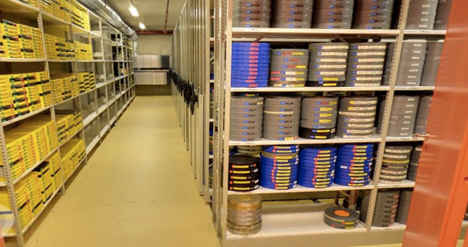

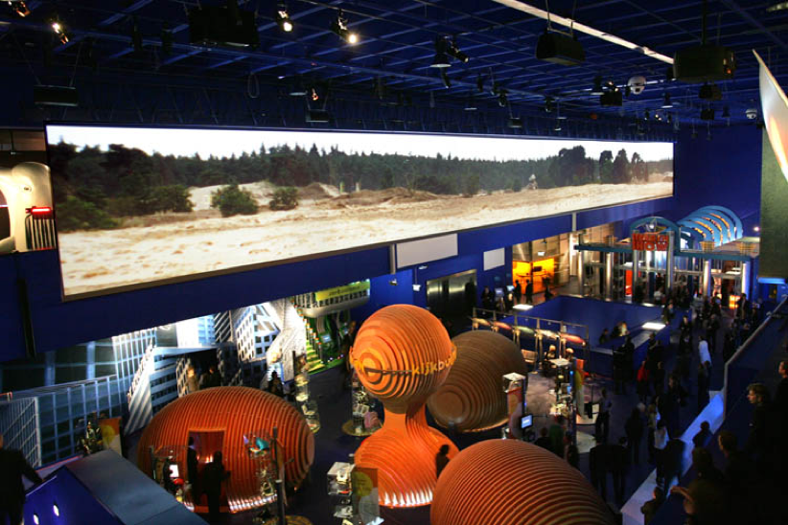

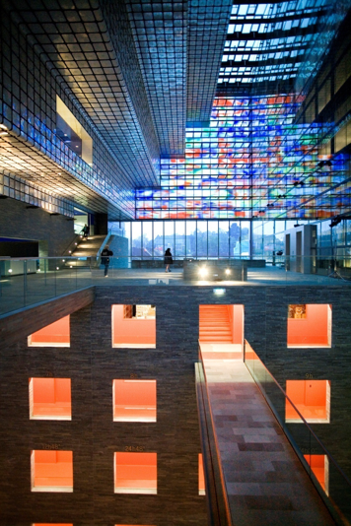

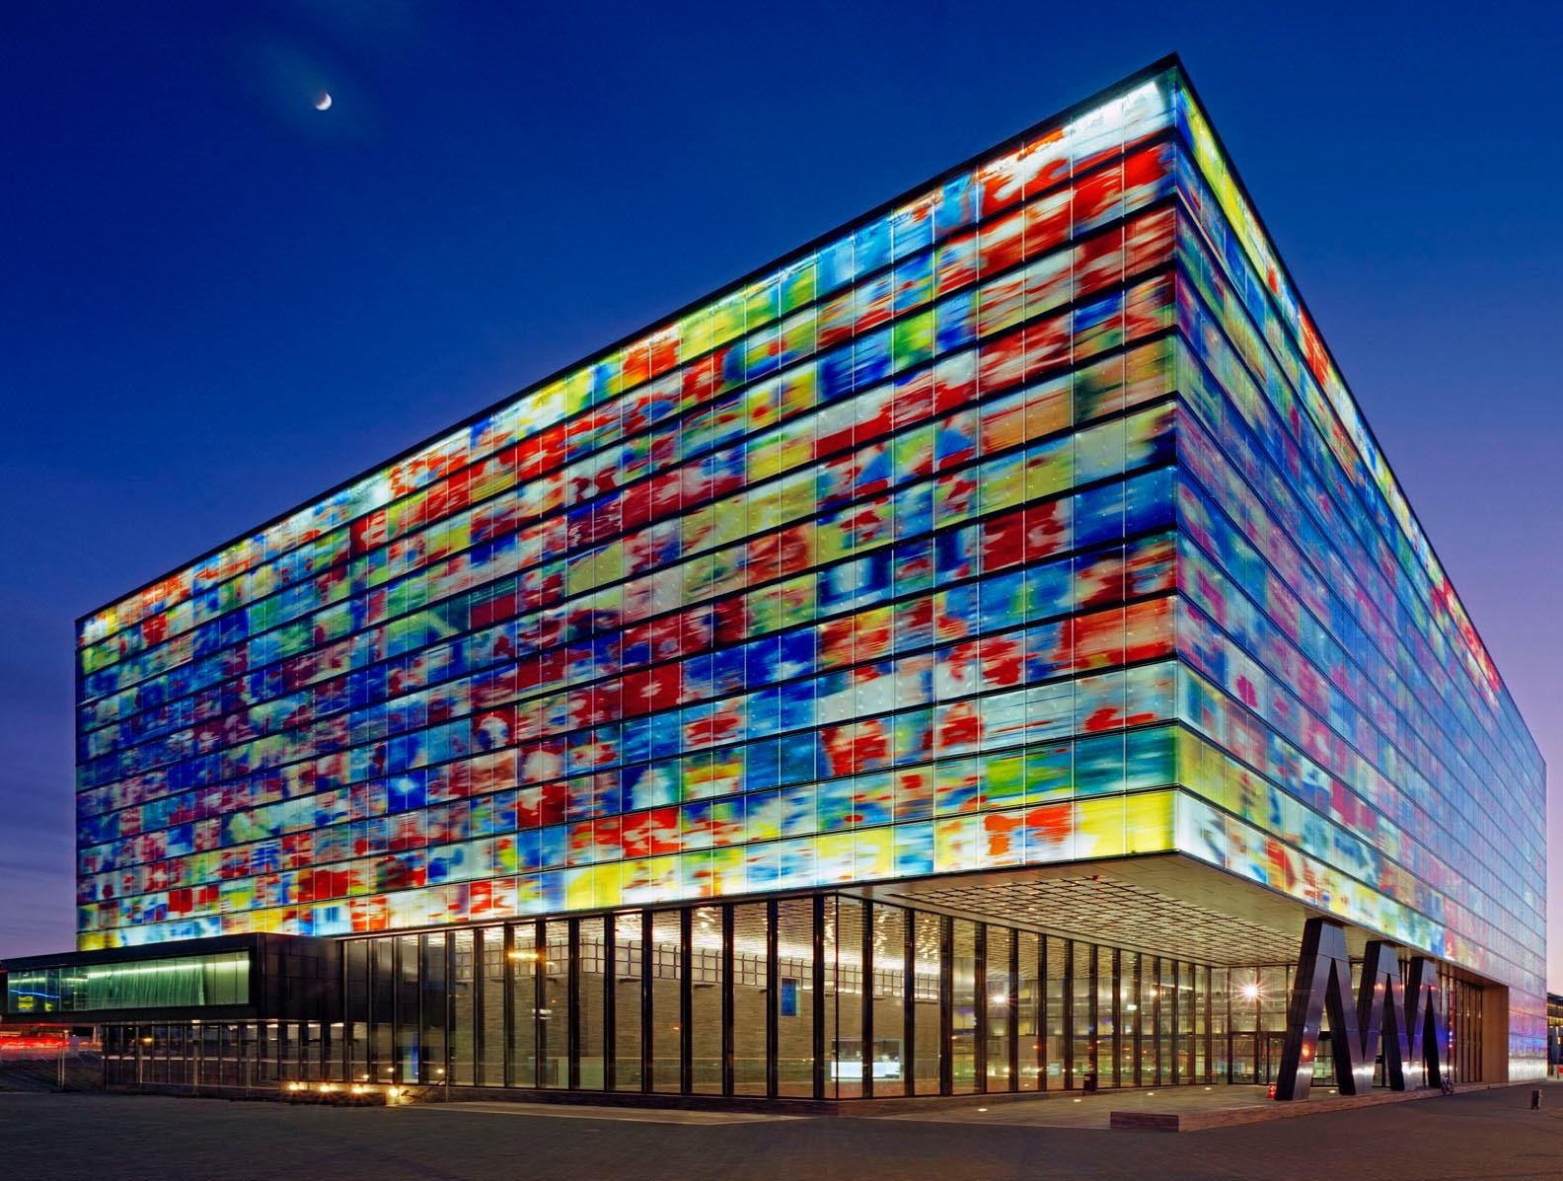
Notes:
“Classic AV archiving”: at the end of the chain, Started after many materials were lost for good.
Don’t have the luxury to make that mistake again
http://www.haykranen.nl/2014/09/22/what-i-learned-from-exhibiting-minecraft-in-a-museum/
https://vimeo.com/51425368

Slide 6

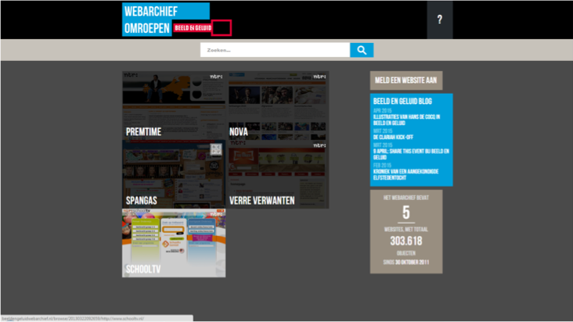

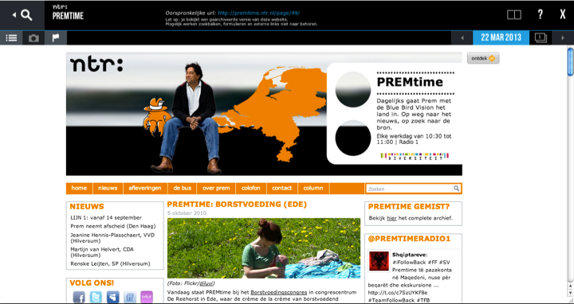
Notes:
Webarchief
a-­posteriori: Crawling the Web (client-based)
a-priori: Approach producers

Slide 7

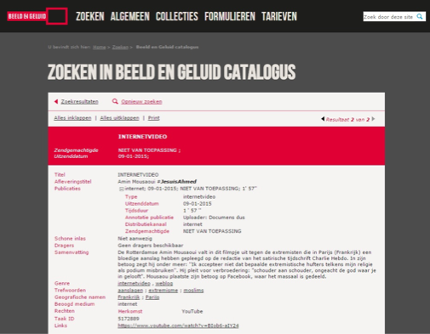

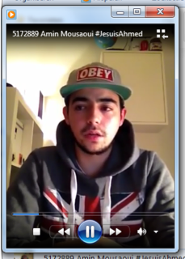
Notes:
Webvideo

Slide 8
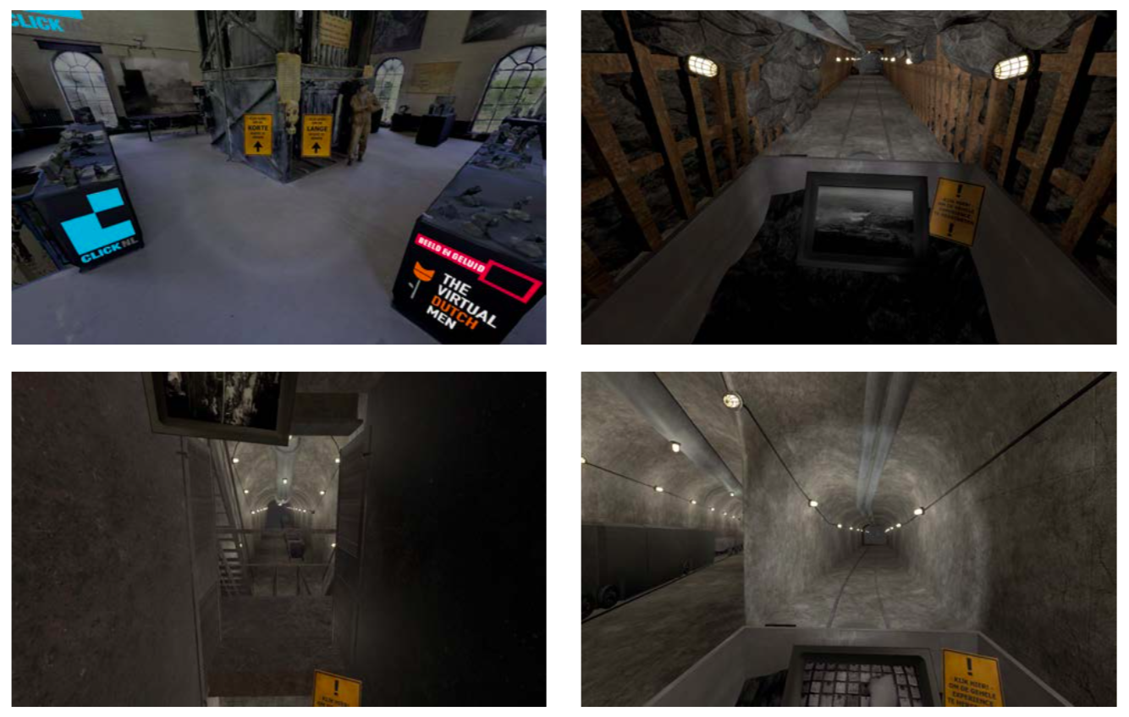

Slide 9
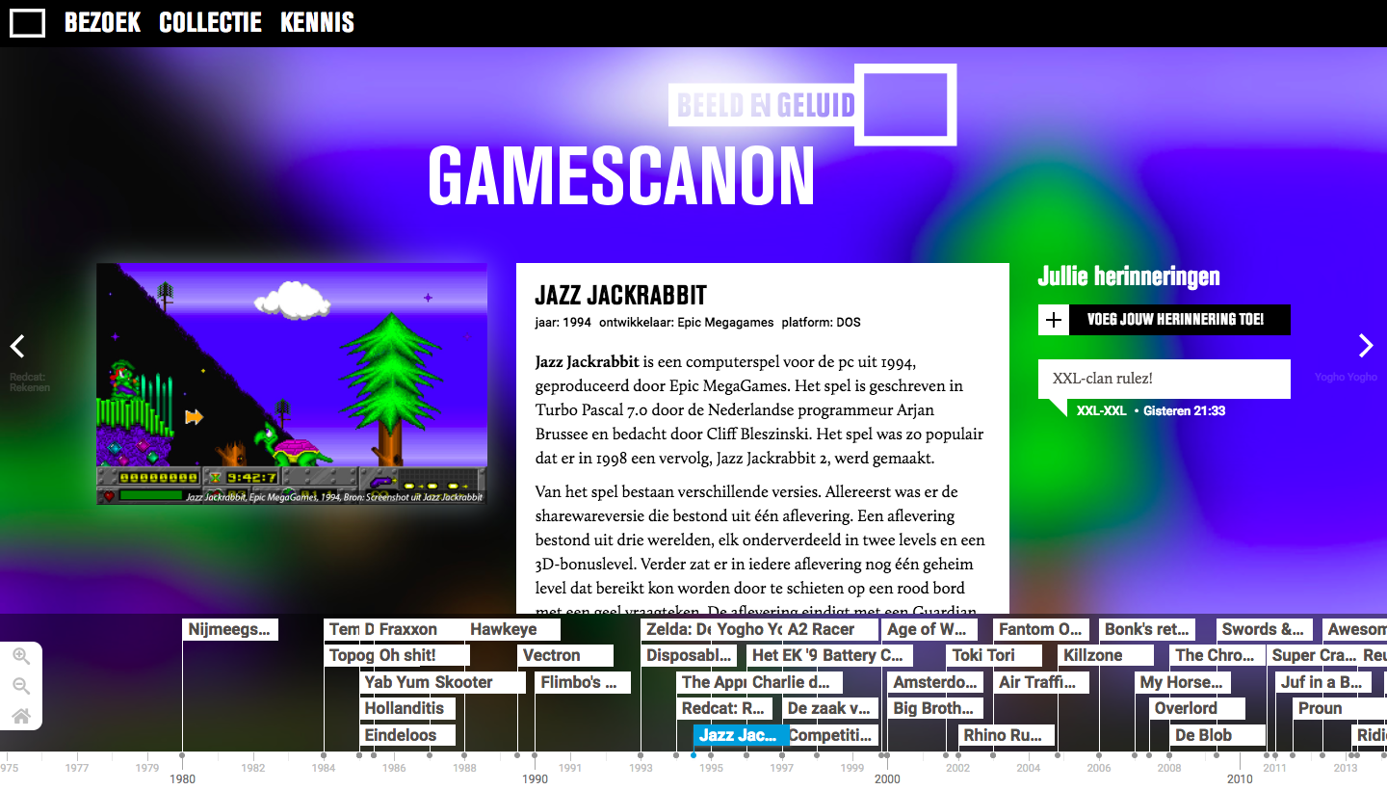

Slide 10
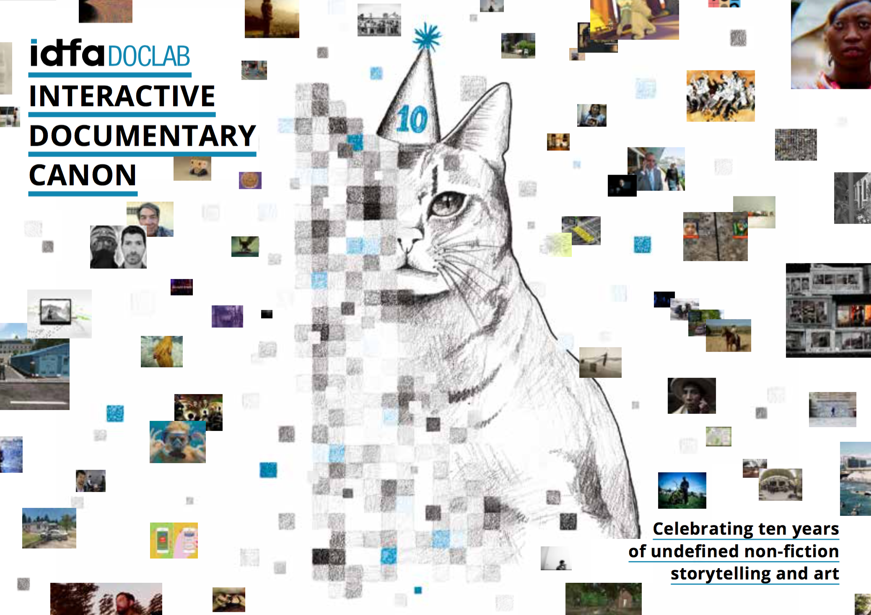
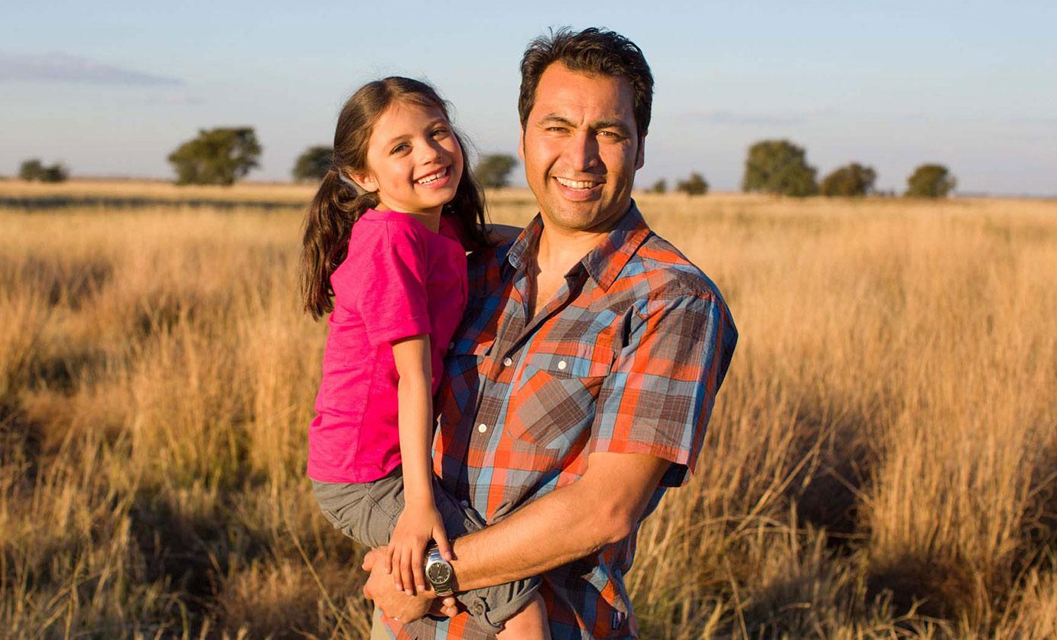
Notes:
This program started by answering the difficult question: which projects should we preserve? That is why they last november they launched: the Interactive Documentary Canon, a list of 100 of the best projects made in the last 10 years, collectively curated by over 30 new media artists, curators and other key figures in the interactive documentary community. This list can be found online at www.idfa.nl/doclab. For those interested in a physical copy, we have also brought a few copies of the IDFA DocLab Interactive Canon anniversary publication.
Last november, IDFA and Sound and Vision also co-organized an expert session on Digital Preservation and later this year, we are collaborating with MIT Open DocLab and Phi Centre, who are organizing the Update or Die Conference on preservationn of interactive documentary in Montreal on 5 & 6 May.

Slide 11
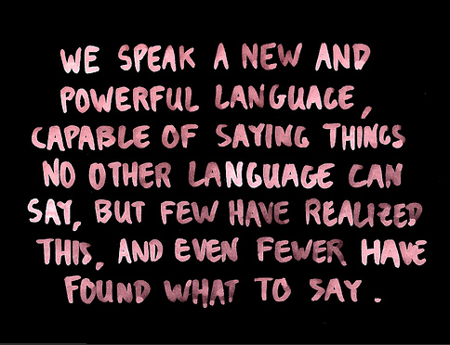
Jonathan Harris
Notes:
Documentary, like great food, deserves our full attention, and as such, we should start creating a part of the web that is slow and create narrative experiences that will still be relevant 25 years from now.

Slide 12
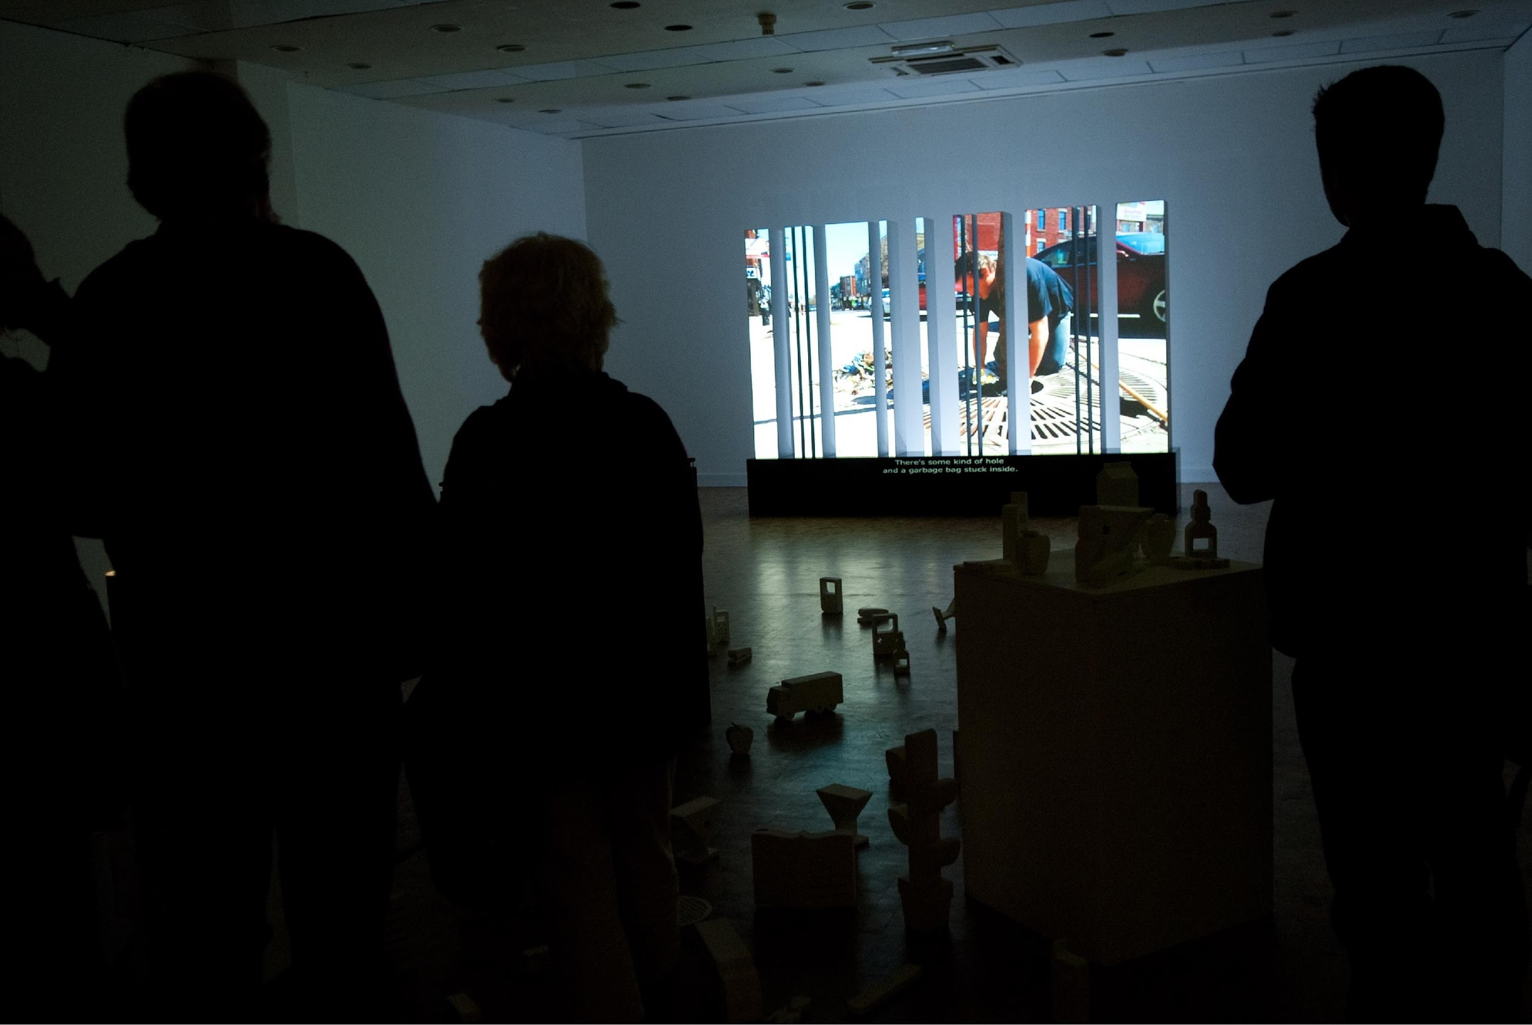
Notes:
Een expositie met zo'n dertig projecten per jaar

Slide 13
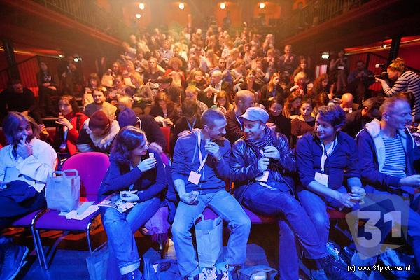
Notes:
Een reeks live events

Slide 14
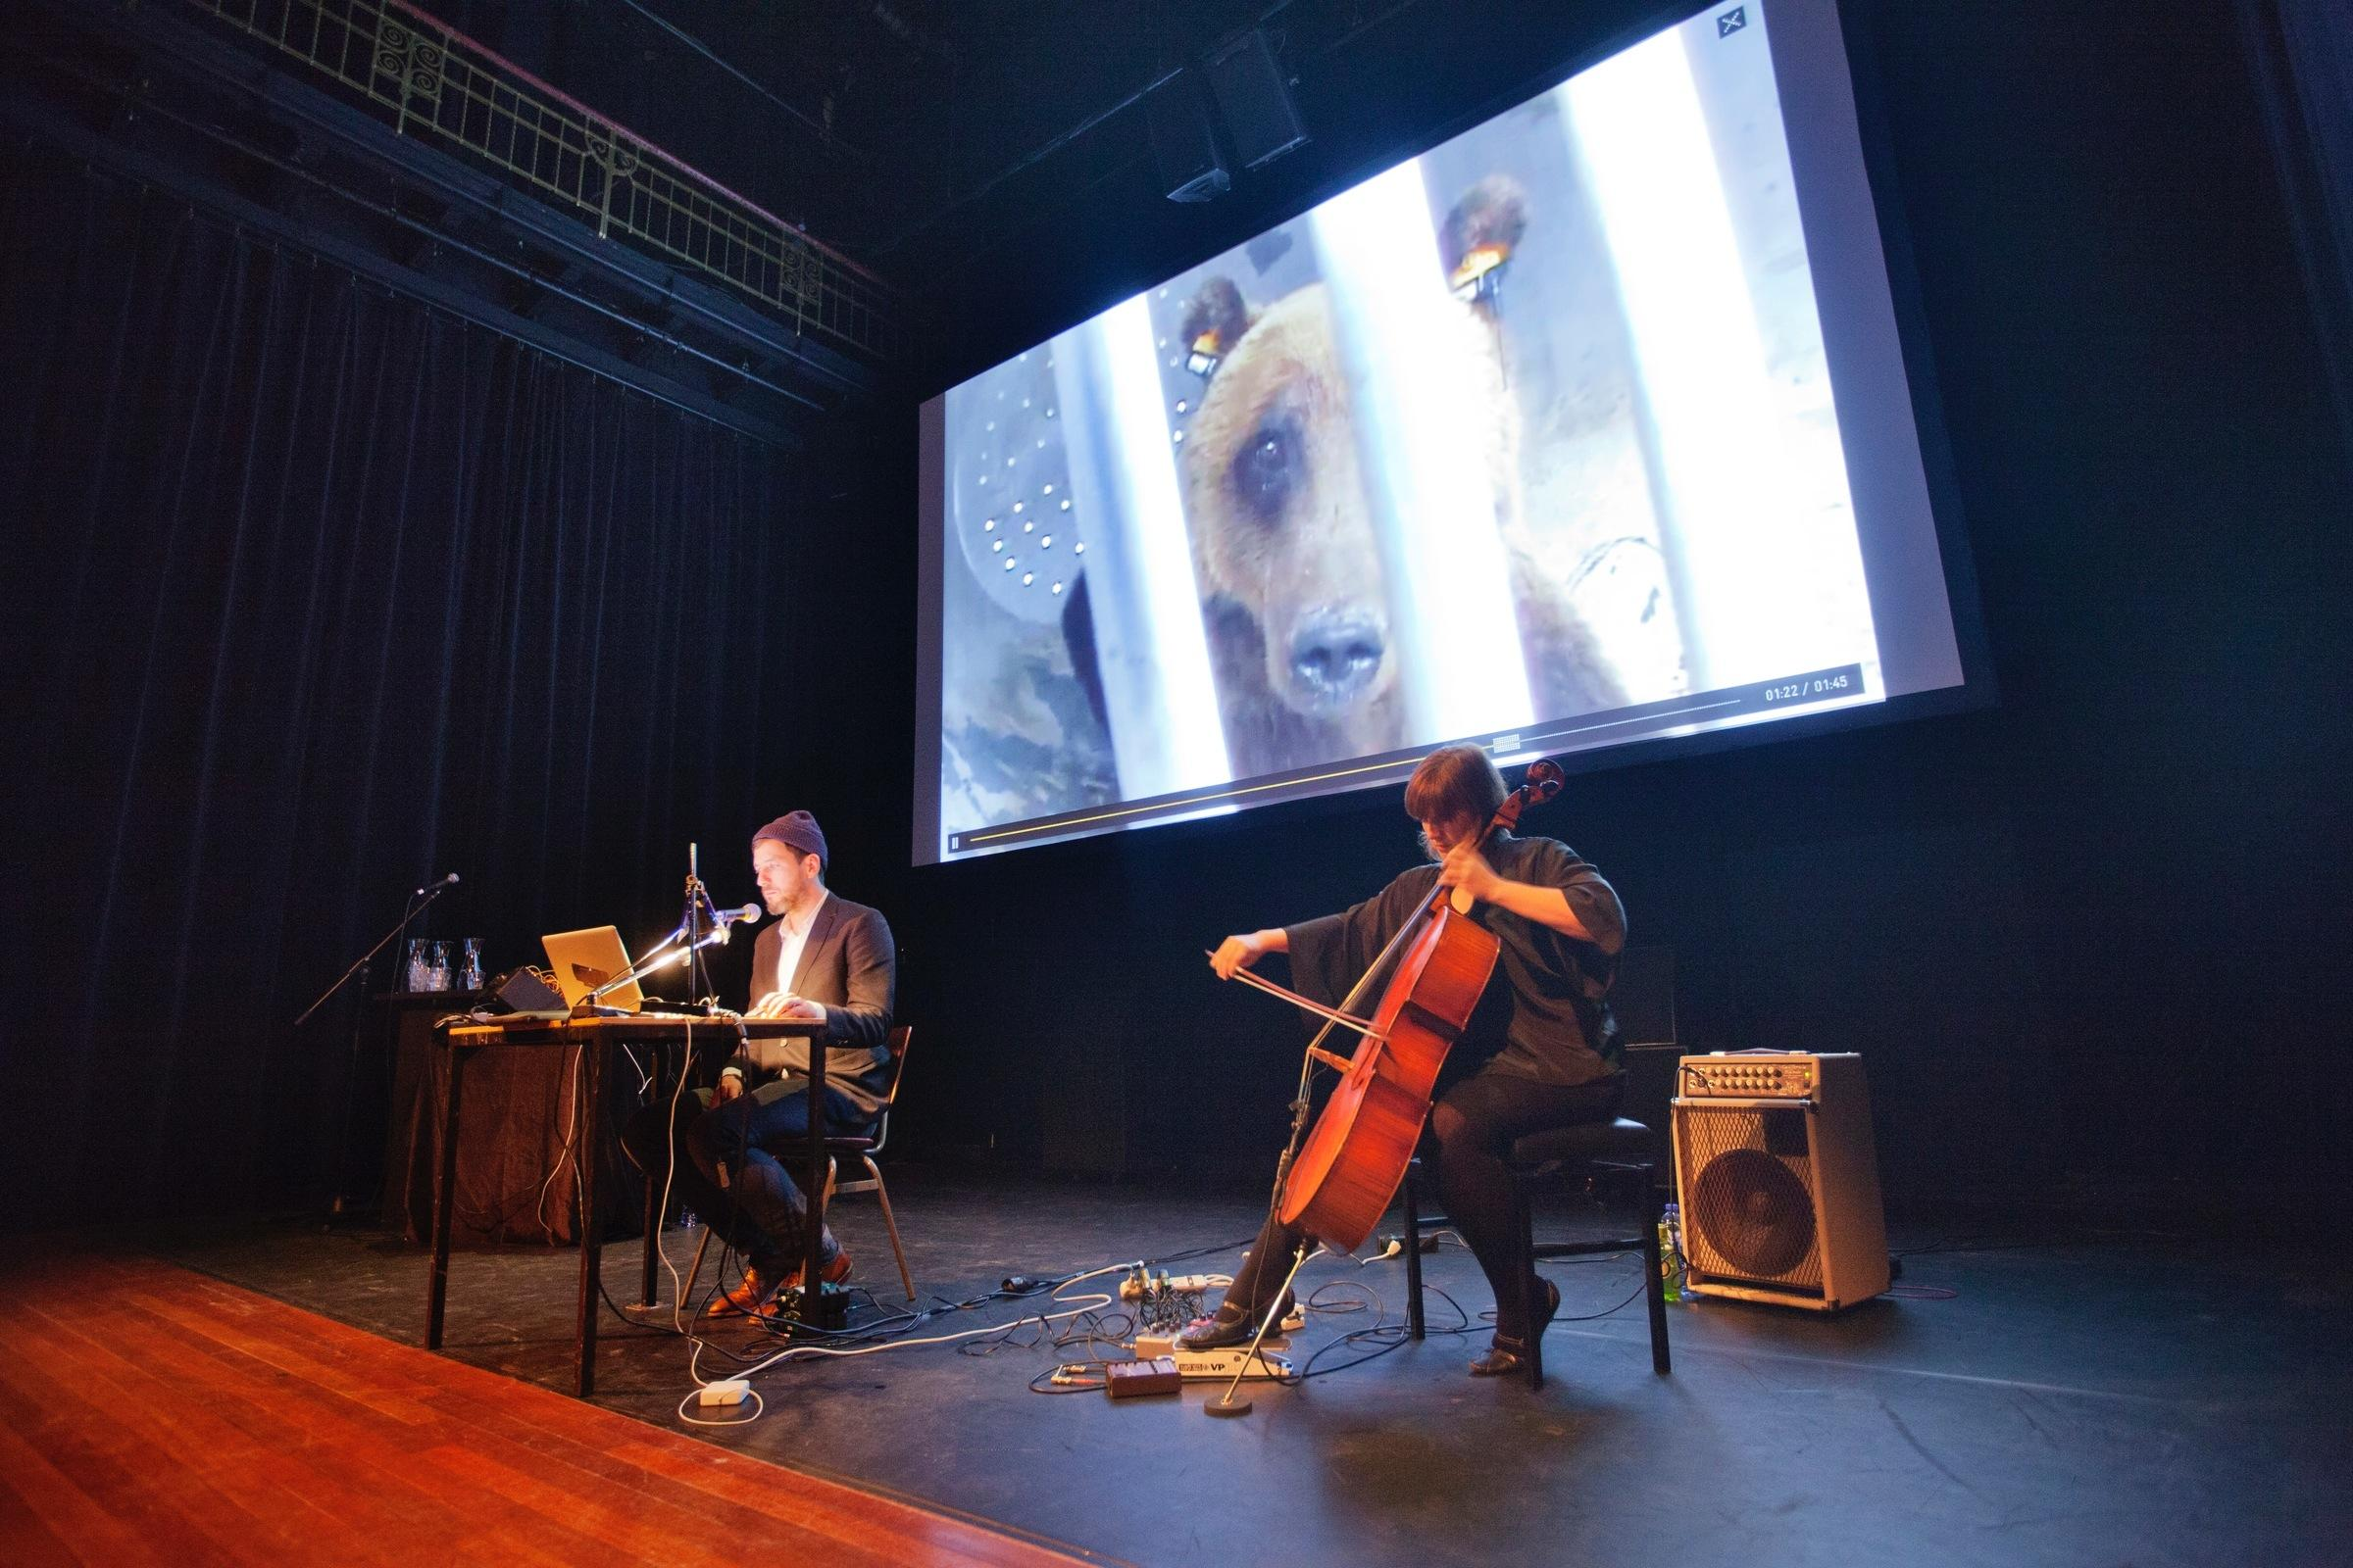

Slide 15
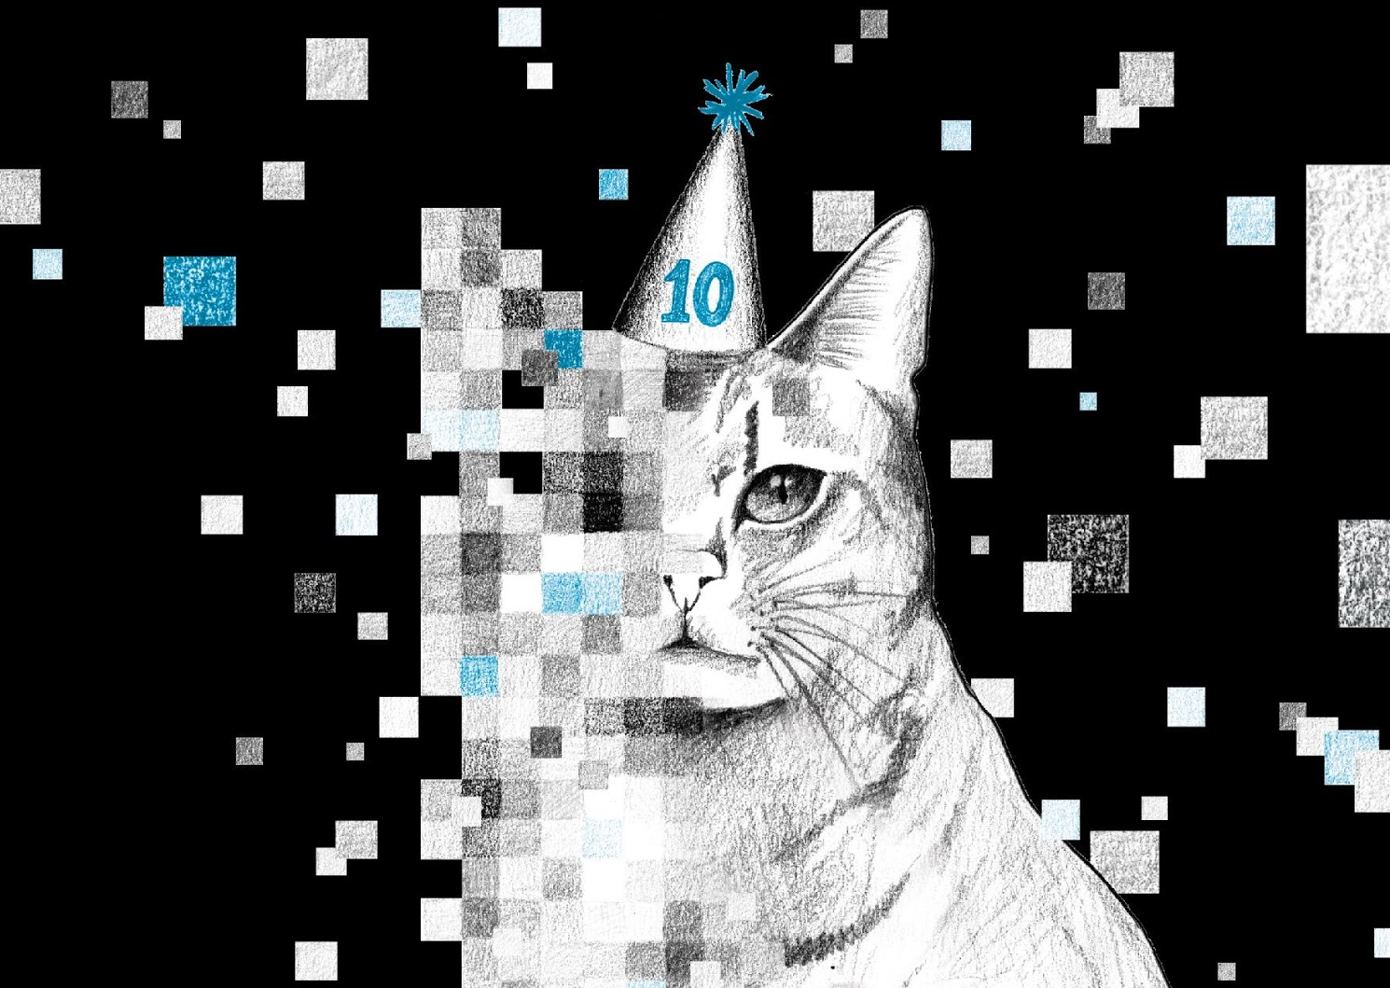
anniversary
Notes:
In 2016 IDFA celebrated the ten year anniversary of its New Media program DocLab. IDFA’s Head of New Media Caspar Sonnen, who has been organising guest panels at SXSW since 2009, couldn’t be here today unfortunately, but asked me to say a few words about what IDFA DocLab is doing around preserving interactive documentary storytelling and art.
Marked by its 10 year anniversary last november, IDFA DocLab has started a four-year project to explore questions and possibilities around preservation of interactive documentary art.

Slide 16
MAIN INGREDIENTS
Notes:
So what type of projects do we look for? I want to avoid going into definitions and words like transmedia,
so in shrort: here is the the four main ingredients that we tend to look for in projects

Slide 17
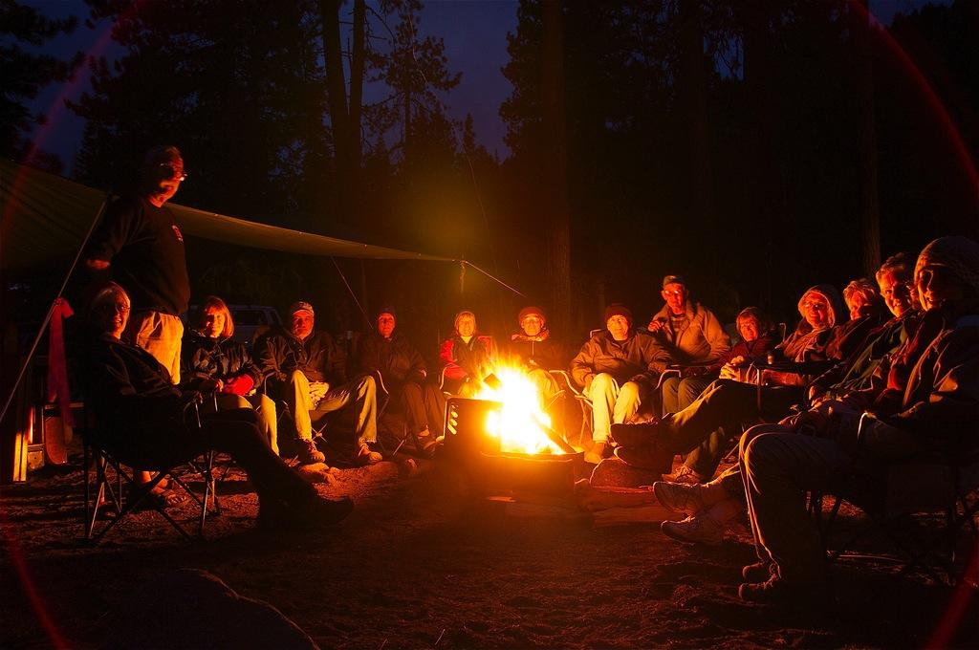
STORY
Notes:
Every documentary tells a story, and the same goes for interactive documentaries.

Slide 18
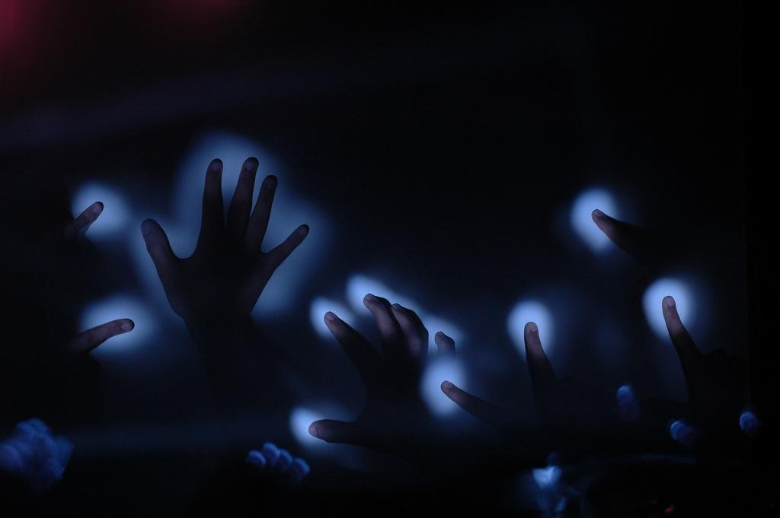
INTERACTION
Notes:
In interactive documentary, interface design is at least as important as camerawork and editing in a documentary film

Slide 19

DIGITAL TECHNOLOGY
Notes:
And we look for projects that creatively use the amazing amount of digital traces of human behaviour left behind on the web.

Slide 20
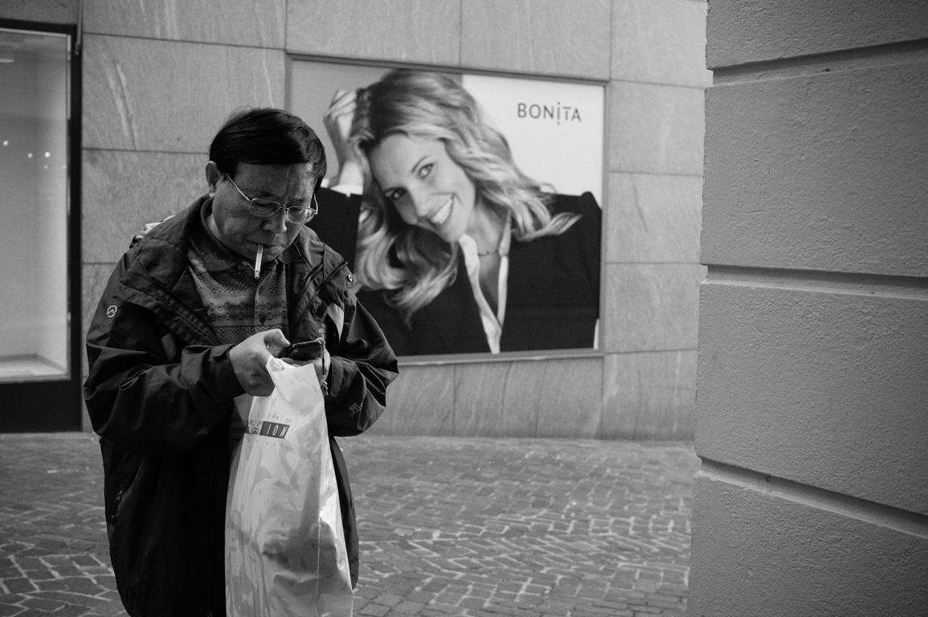
CAPTURED REALITY
Notes:
We look for projects that capture an existing reality, as opposed to fiction projects that create a new reality. Although the boundary always is a bit blurry.

Slide 21

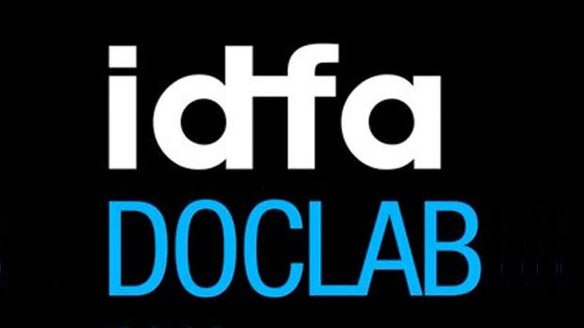

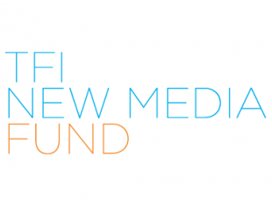
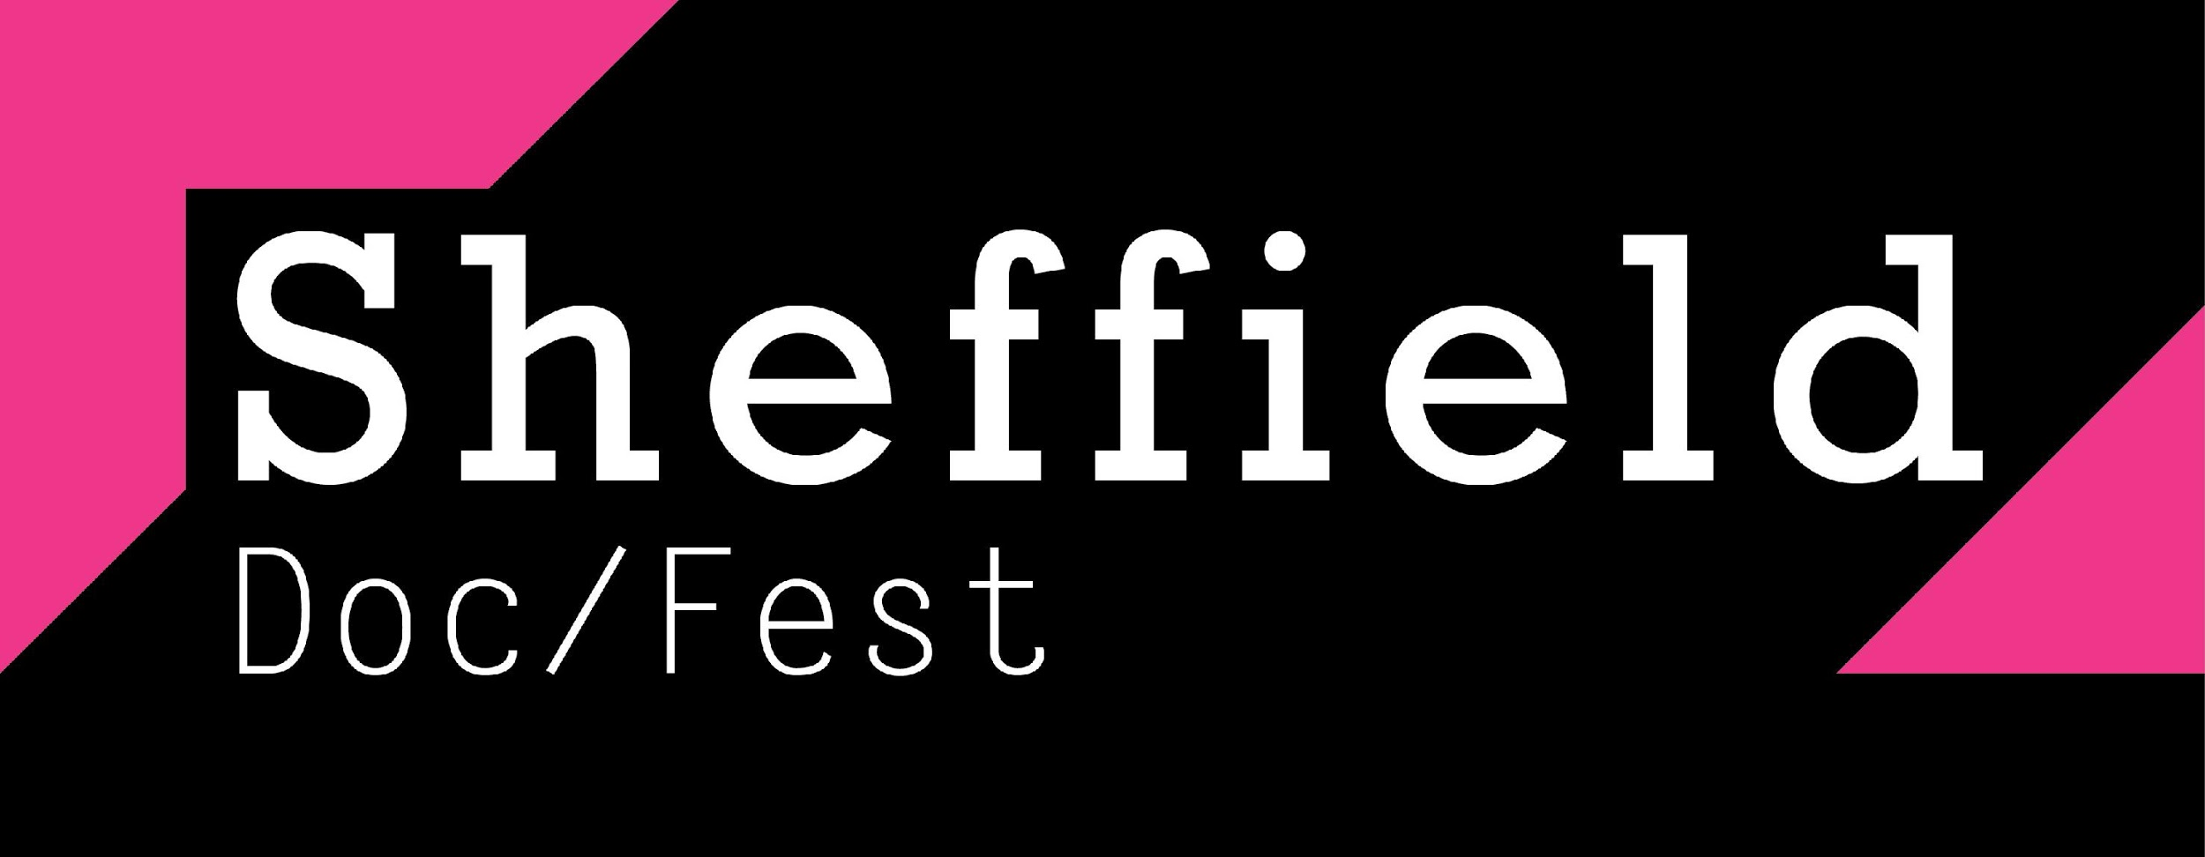







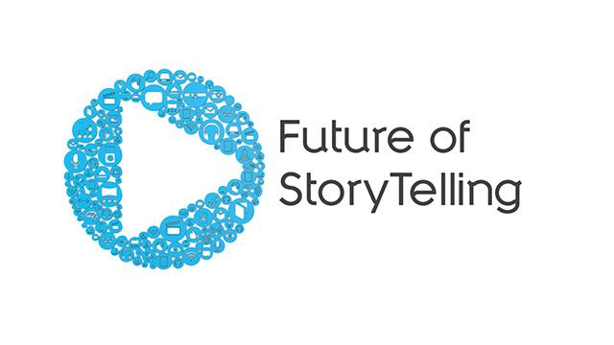



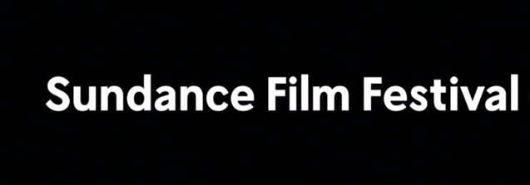
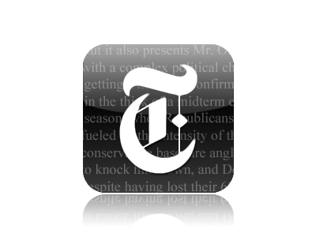

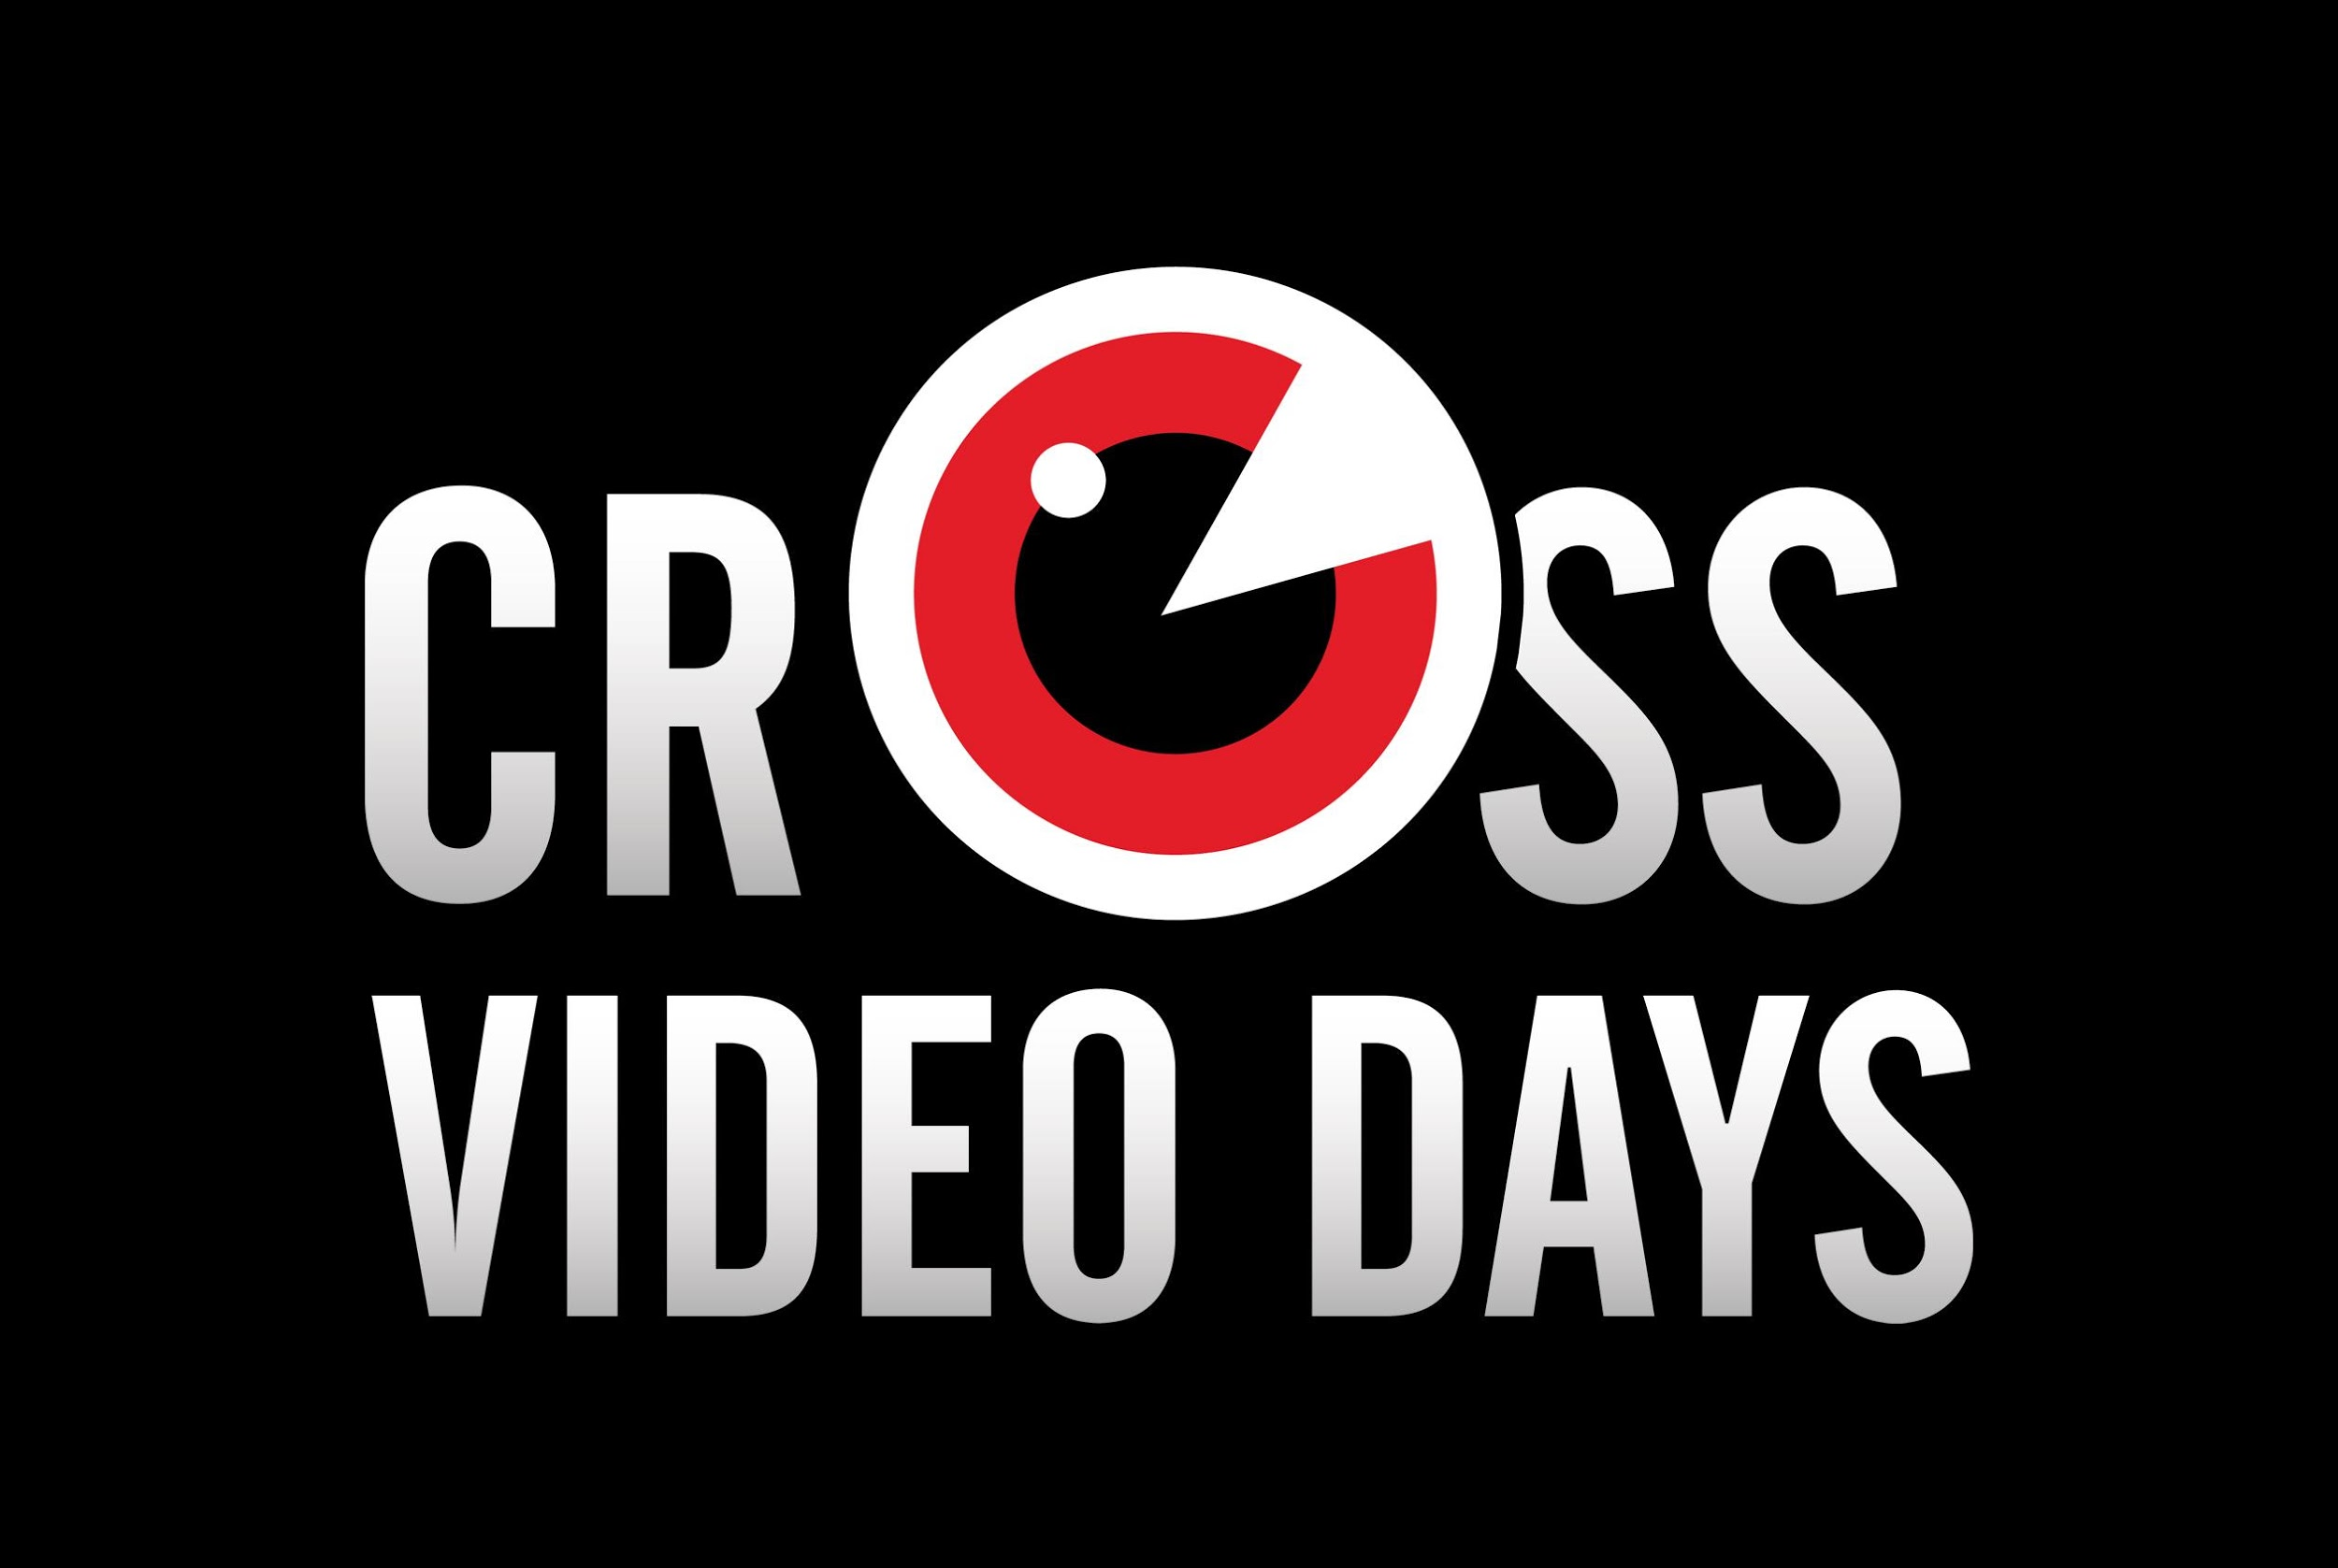


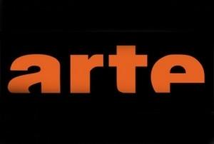
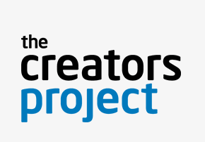


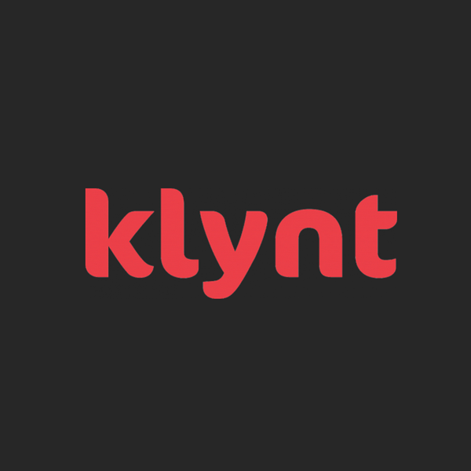
Notes:
Dit heeft een Ecosysteem opgeleverd waarmee het steeds makkelijker wordt om internationaal samen te werken, en Nederland kan hierin een voortrekkersrol gaan spelen.

Slide 22
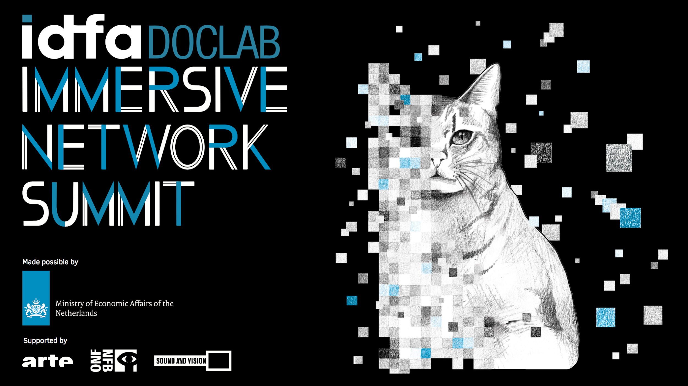
Notes:
Mede daarom zijn we met steun van EZ een pilot programma gestart, bestaande uit research, netwerk events en het initiëren van experimenteel nieuw werk waarvoor het festival als testbed en springplank kan fungeren

Slide 23
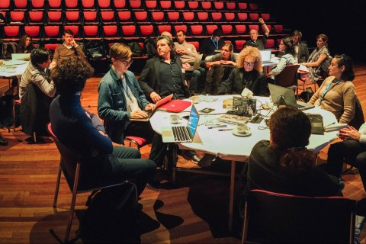
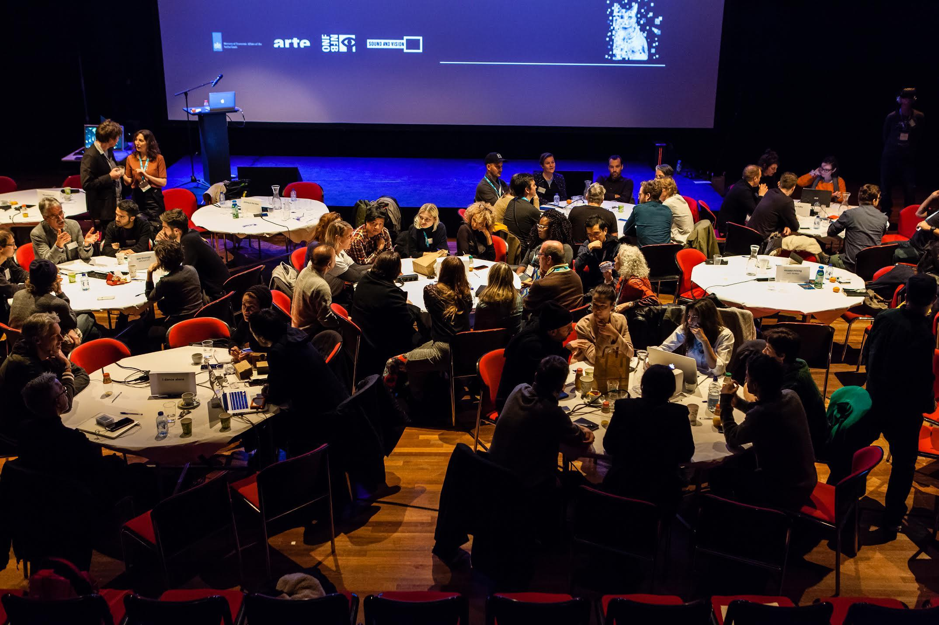
Notes:
[higher-res afbeelding moet ik zoeken - EV]
Naast nationale en internationale netwerk events, organiseren we talent programmas, doen we gebruikersonderzoek en initieren we nieuwe samenwerkingen en experimentele projecten

Slide 24
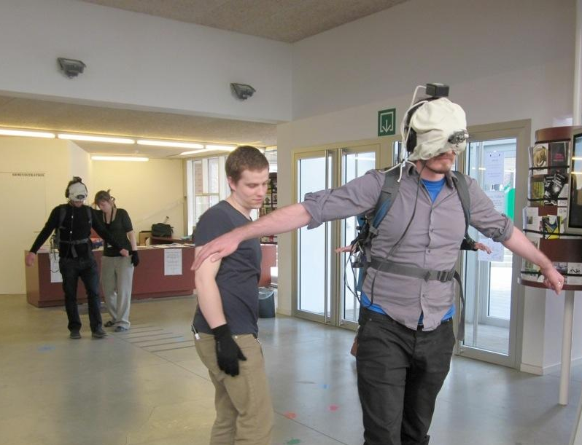
Notes:
In 2010, we started showing our first VR projects

Slide 25
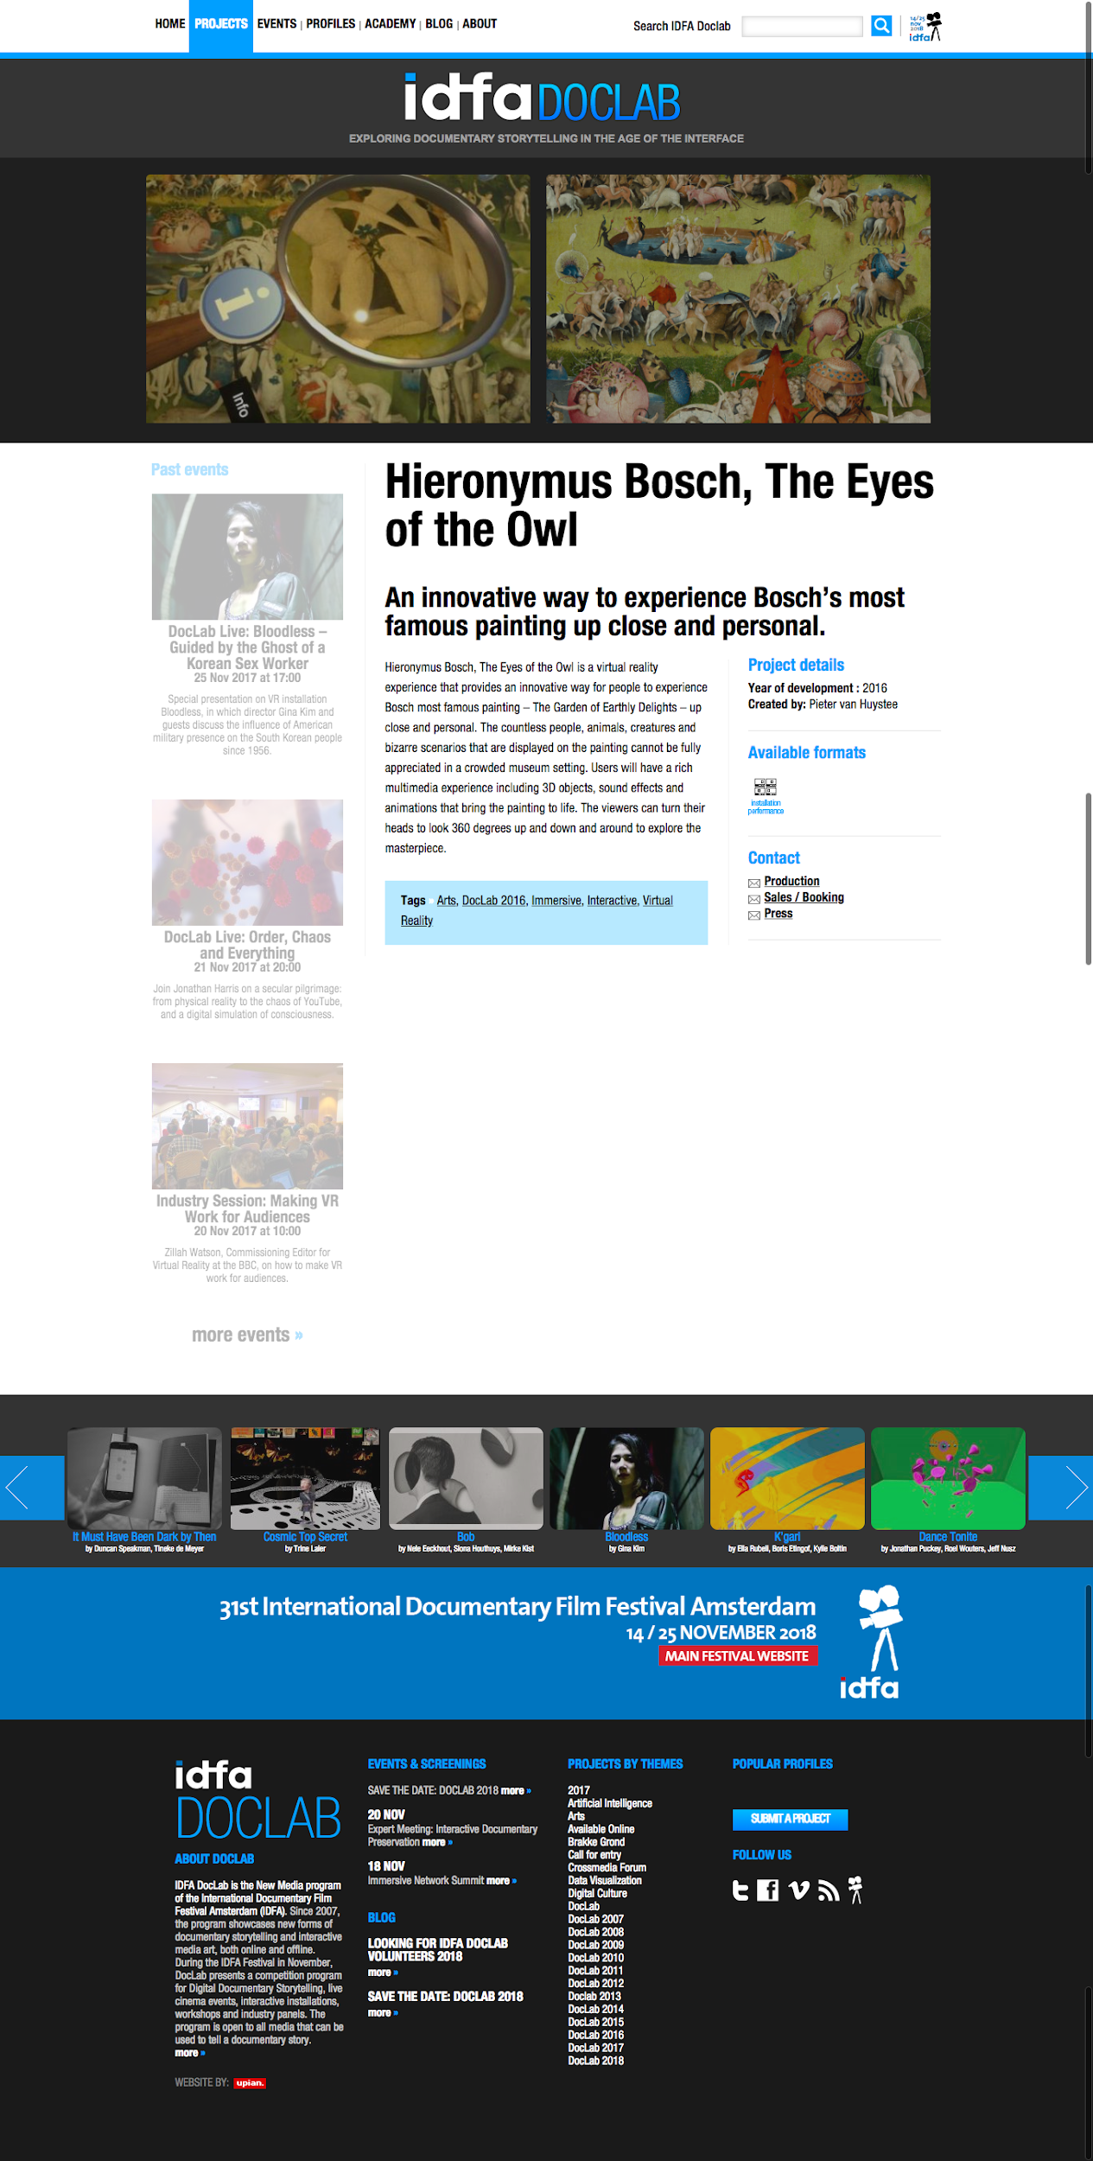

Slide 26
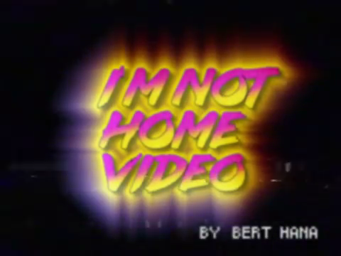

Slide 27
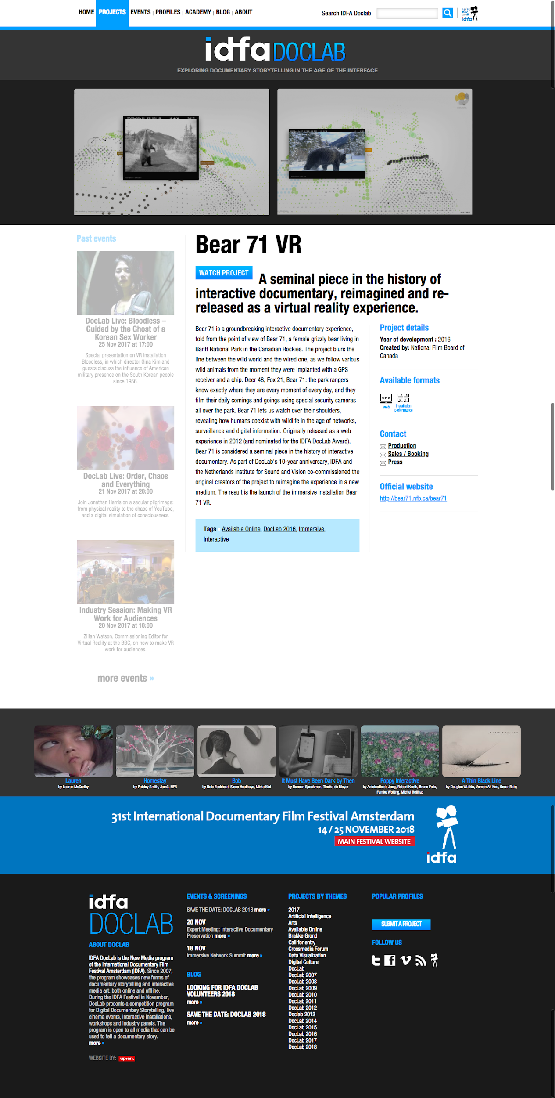

Slide 28
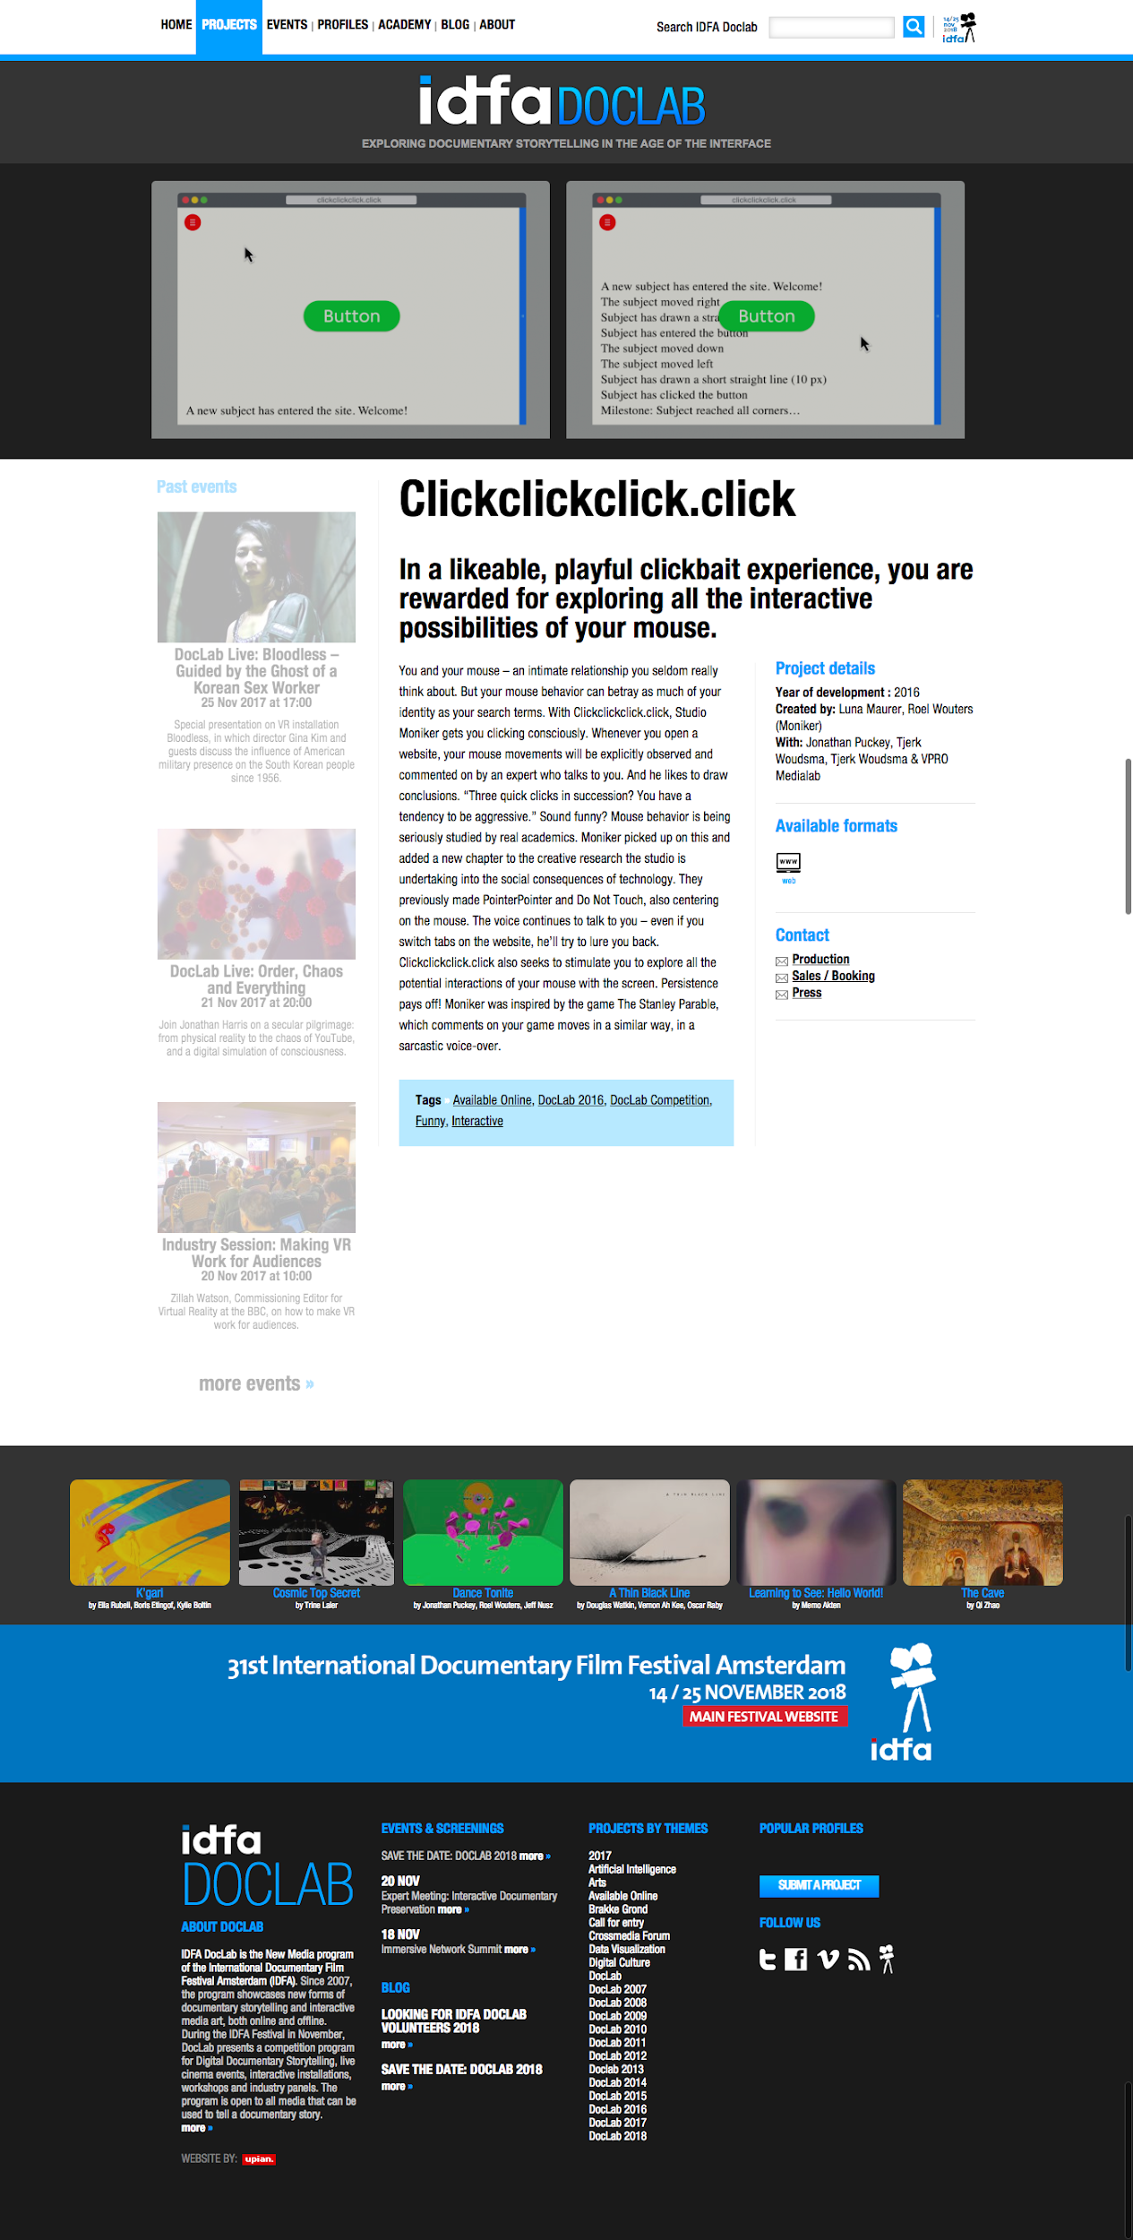


Slide 29
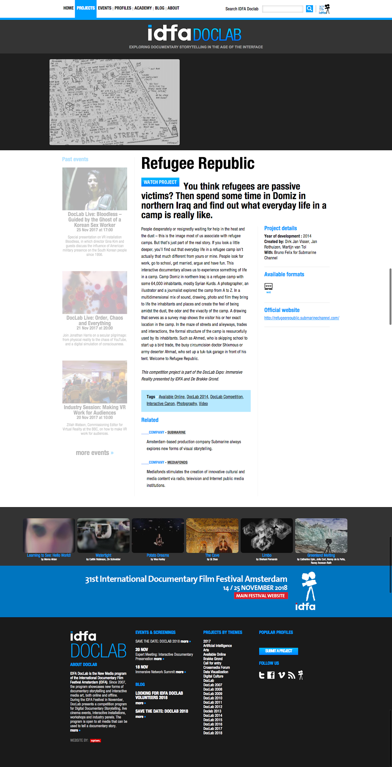

Slide 30
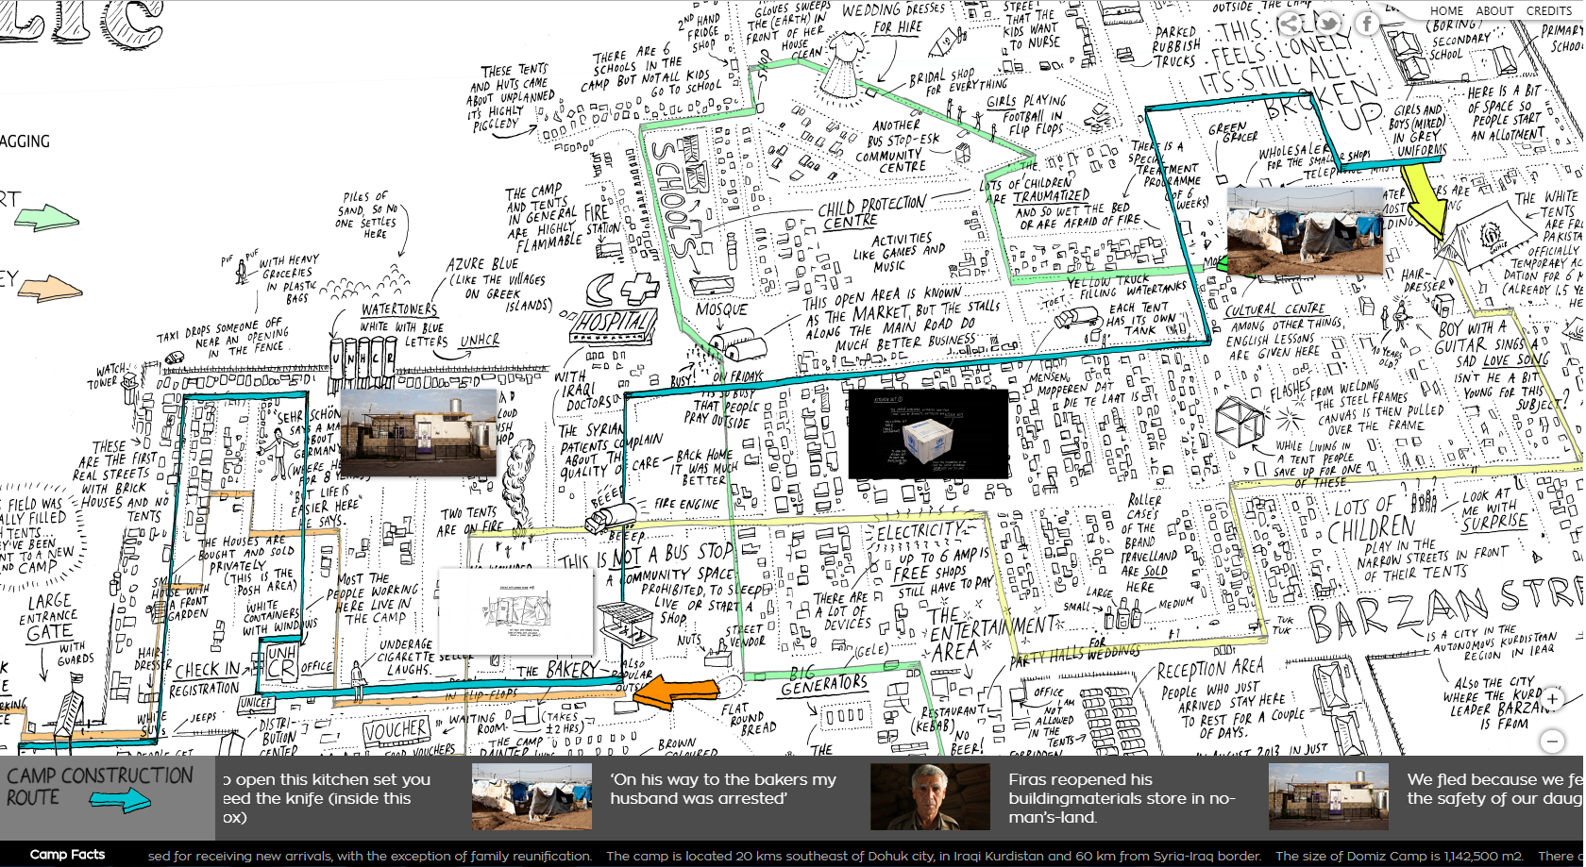

Slide 31
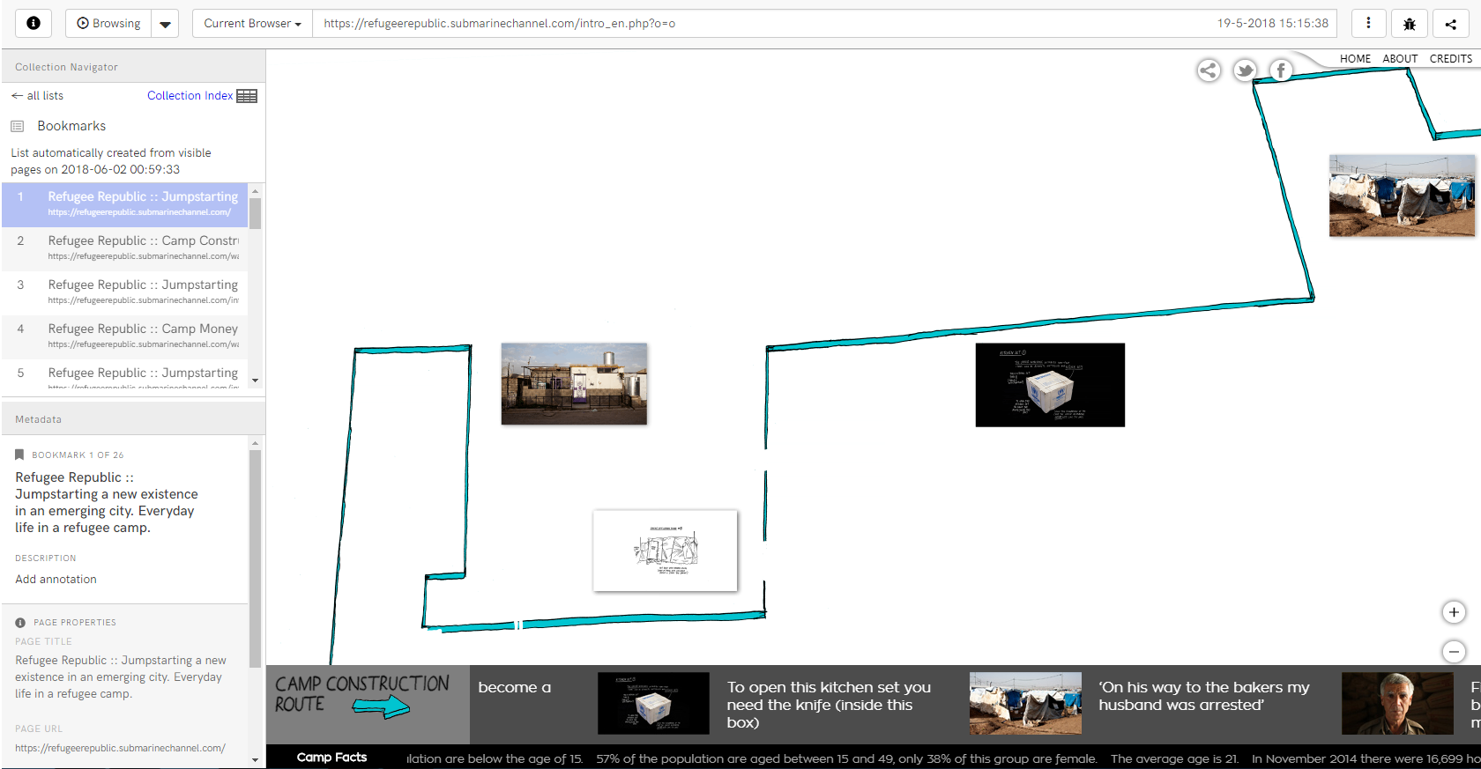

Slide 32
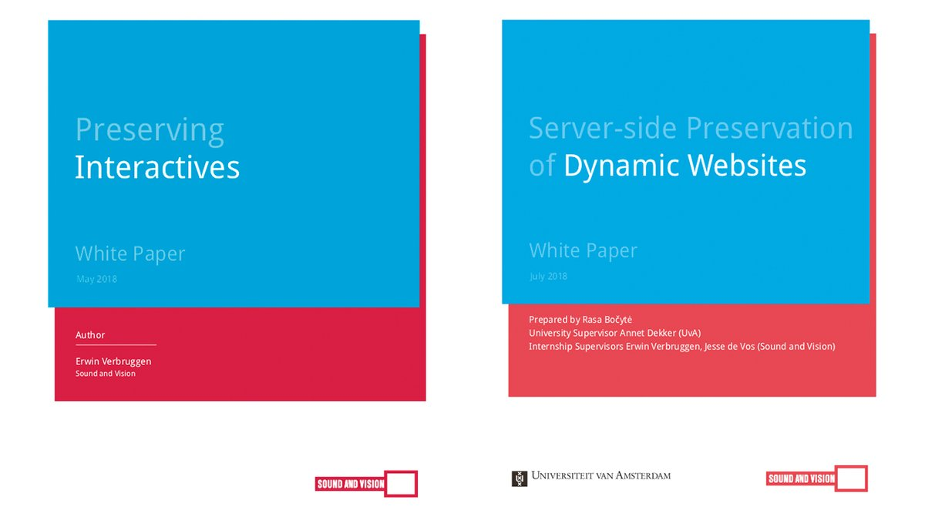
http://publications.beeldengeluid.nl

Slide 33






Breathe A Ghost Story by Kate Pullinger
Caylin Smith, Legal Deposit Libraries Senior Project Manager
No Time to Wait, BFI, London, October 25th 2018

Slide 34
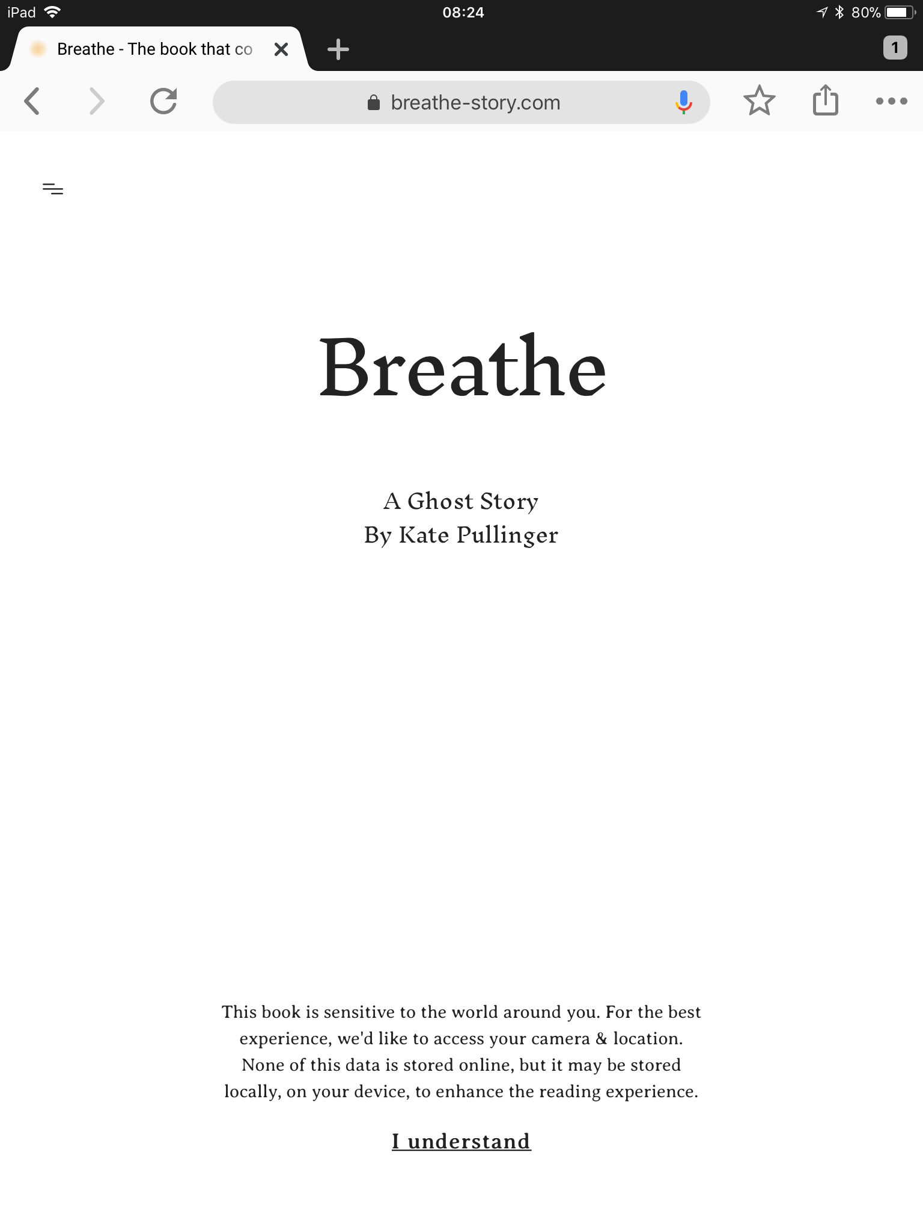
Outline
Context
UK Non-Print Legal Deposit
Emerging Formats project
About Breathe
https://breathe-story.com/
Capturing Breathe using web archiving tools
Heritrix
Webrecorder

Slide 35
UK Non-Print Legal Deposit
Legal Deposit has existed in the UK in some form since 1662
The Legal Deposit Libraries Act 2003
1 copy of a publication sent to the British Library and any of the other libraries that claim it
The Legal Deposit Libraries (Non-Print Works) Regulations 2013
Allowed the libraries to collect publications created in digital formats
Publishers must deposit a digital file that is suitable for long-term preservation
Currently collect eBooks (EPUB and PDF), eJournals (PDF), maps (raster and vector formats), notated music (PDF), and the UK web domain (WARC)
Preserved within the British Library’s digital repository
Access provided onsite on designated desktop terminals at each LDL

Slide 36
Emerging Formats project
Two year project (April 2017 – present)
Identifying publications that are in scope to collect under legal deposit
Exploring the collection management needs of more-complex digital publications
Focused on three types of content
eBook mobile apps (e.g. academic books, dictionaries, children’s literature)
Web-based interactive narratives (e.g. narrative games, ambient literature, literature written for platforms like Twine)
Structured data (e.g. statistics, official reports)

Slide 37
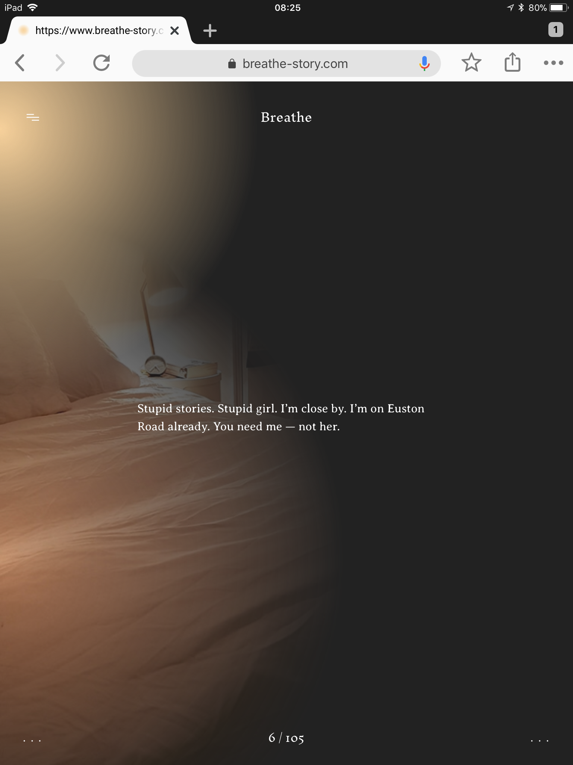
About Breathe
Created by Kate Pullinger in collaboration with Editions at Play (Visual Editions + Google’s Creative Lab)
Read time 15-20 minutes; 105 pages in total
Browser-based work of ambient fiction written in HTML that is best viewed on mobile devices
Reader progresses the narrative by swiping left on their mobile device, or touching icon in bottom right corner
Uses APIs to personalise the narrative to the reader’s surroundings
Use of device’s camera, GPS, and weather data
a “book that comes to you”

Slide 38
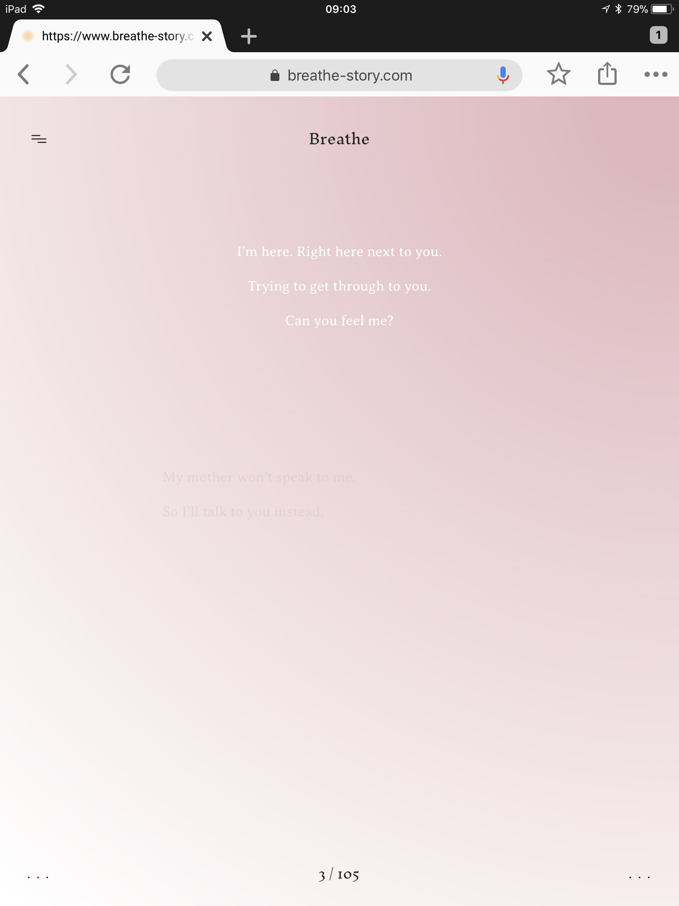
Observations
Mainly textual, but does include some images
Use of device’s camera to create background imagery
Different types of interaction (e.g. tilting the screen) are required to reveal the full story
The narrative does not always appear immediately onscreen
Behavior is impacted by type of device (mobile phone, tablet), operating system (iOS, Android), browser
Notes:
On an Android mobile, the book will only render when the device is held in portrait mode:
Device settings will impact the personalized aspects of the narrative

Slide 39
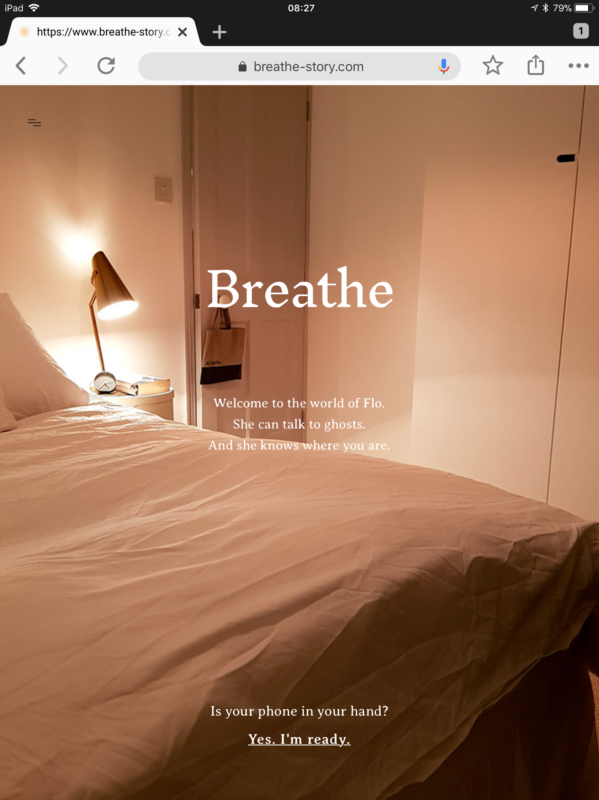
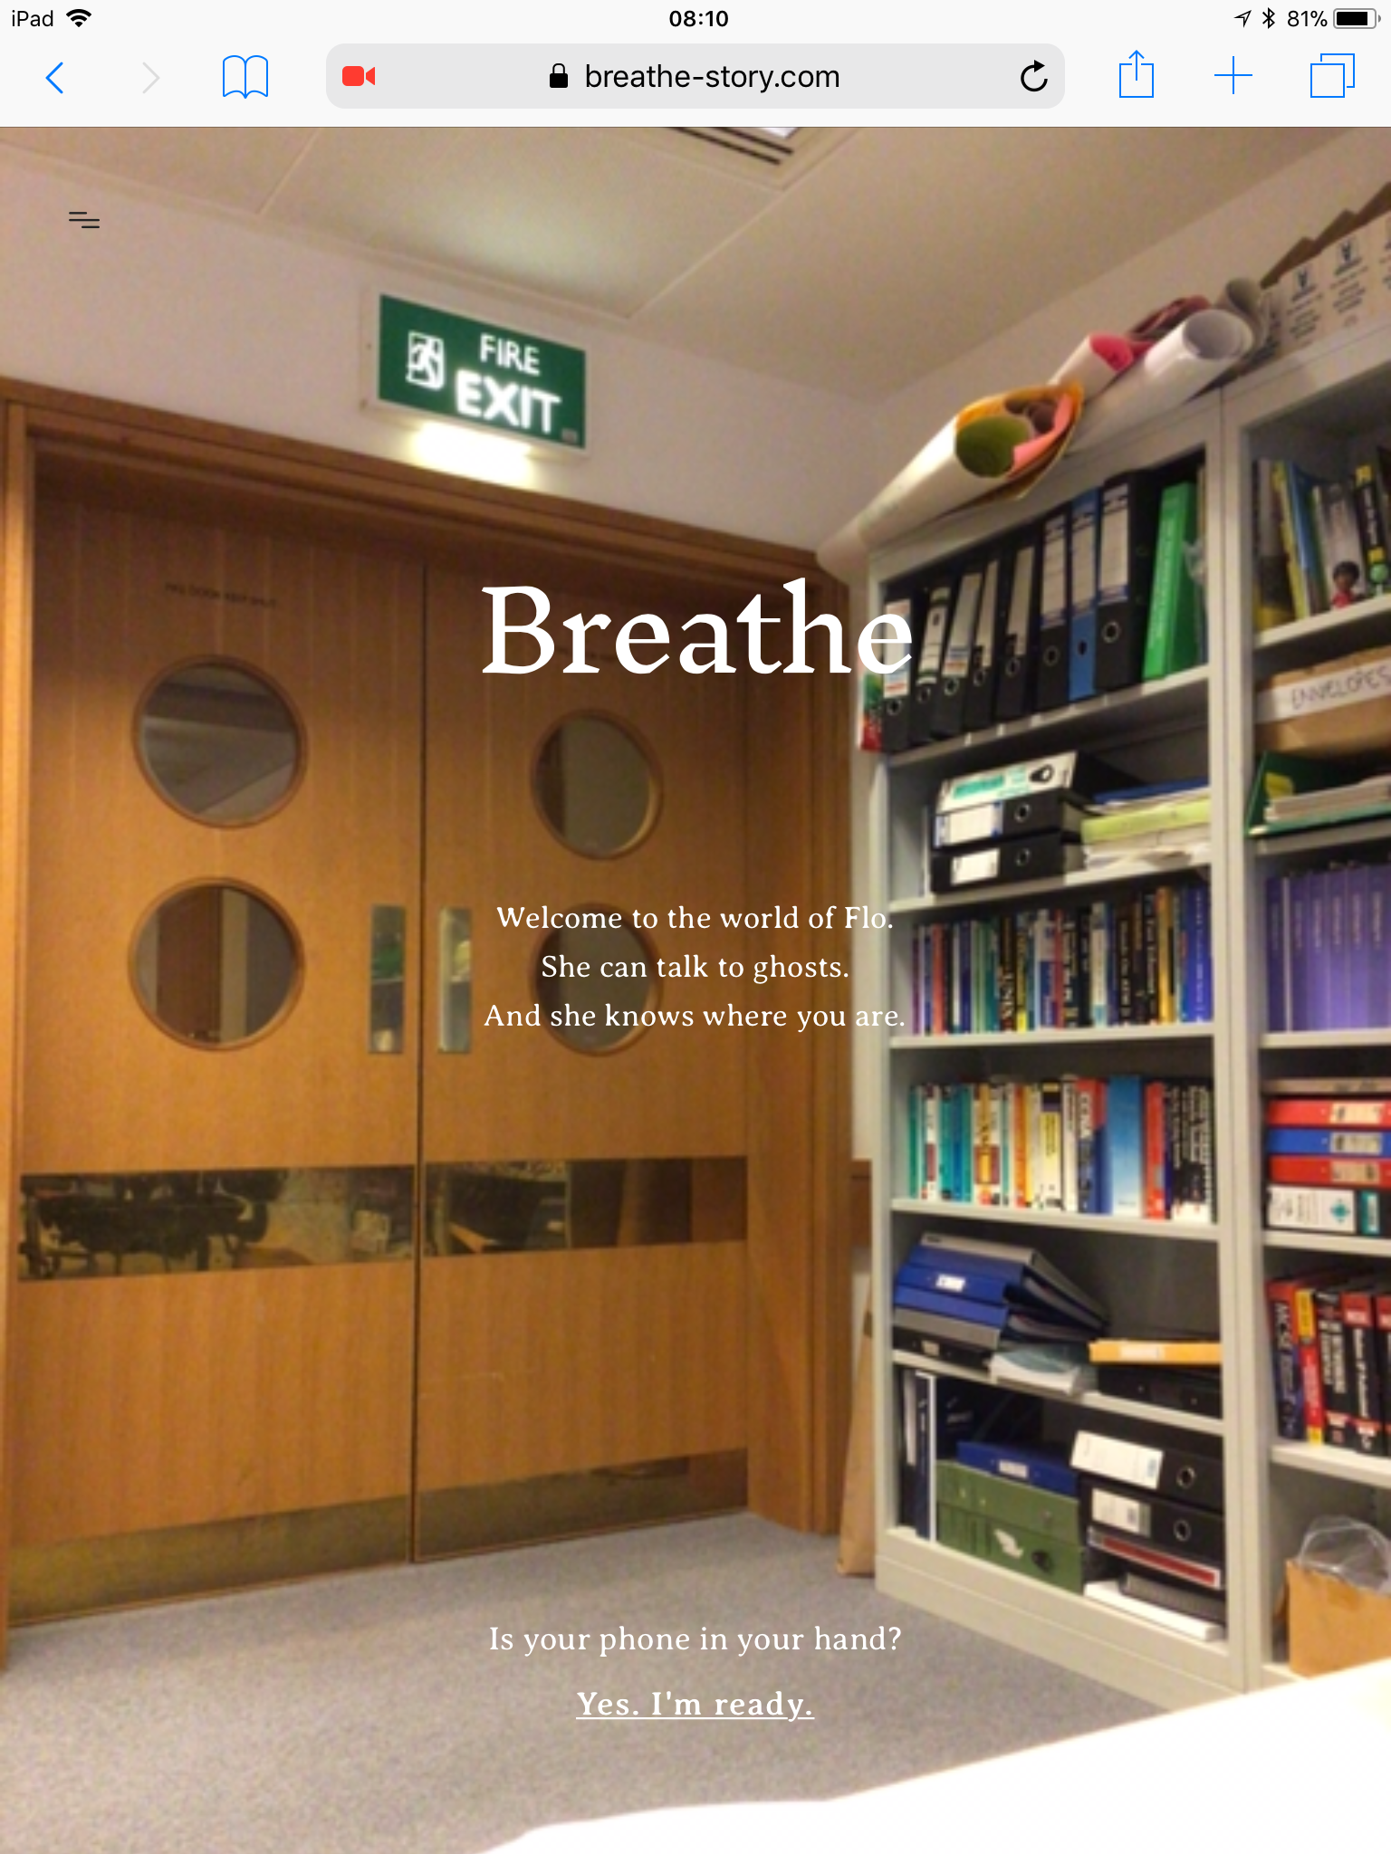
Breathe as displayed in Chrome
Breathe as displayed in Safari

Slide 40
Capturing Breathe
Heritrix
Web Recorder

Slide 41
Heritrix

Slide 42
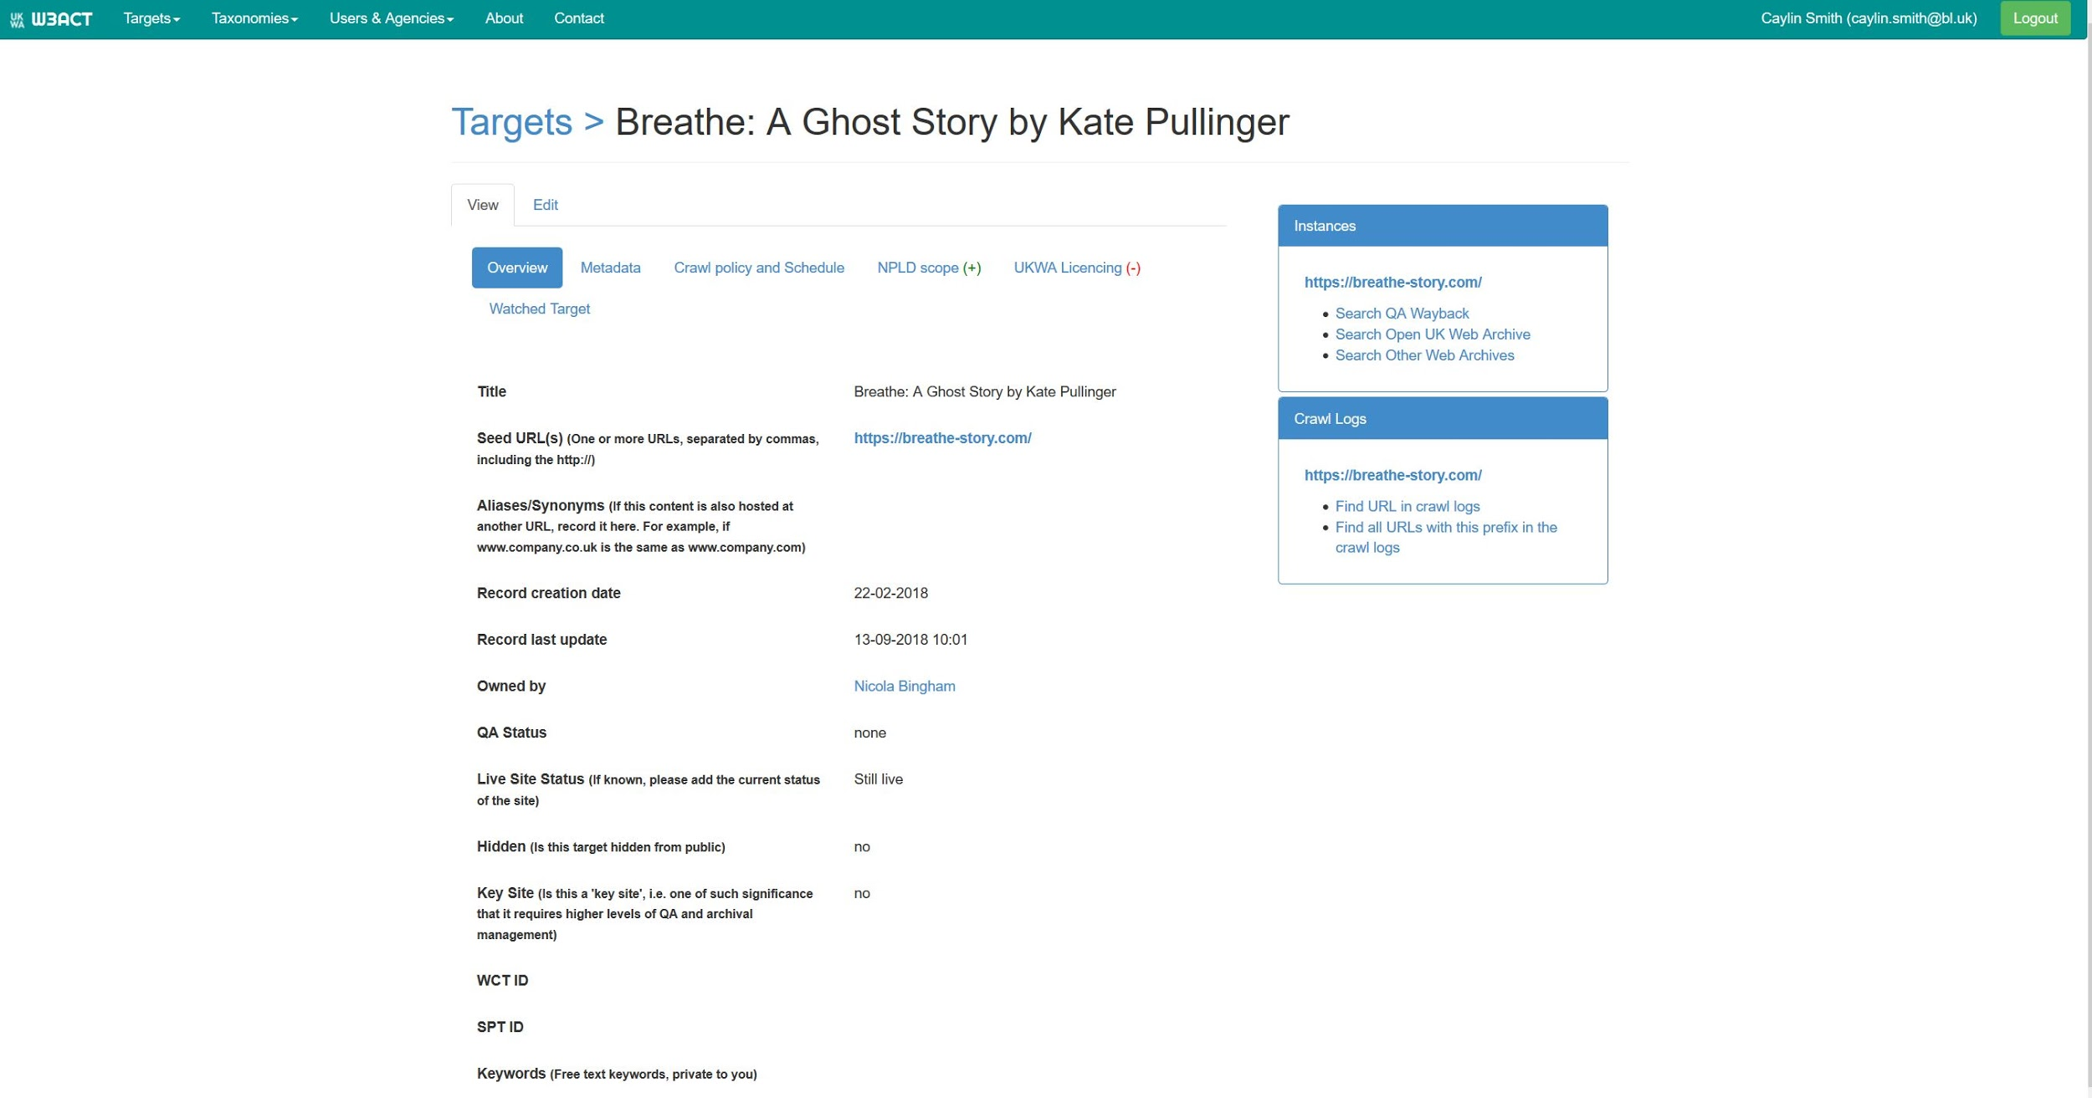
Screen capture of Breathe within the BL’s Annotation Curation Tool, an open source, selective web archiving workflow management application

Slide 43
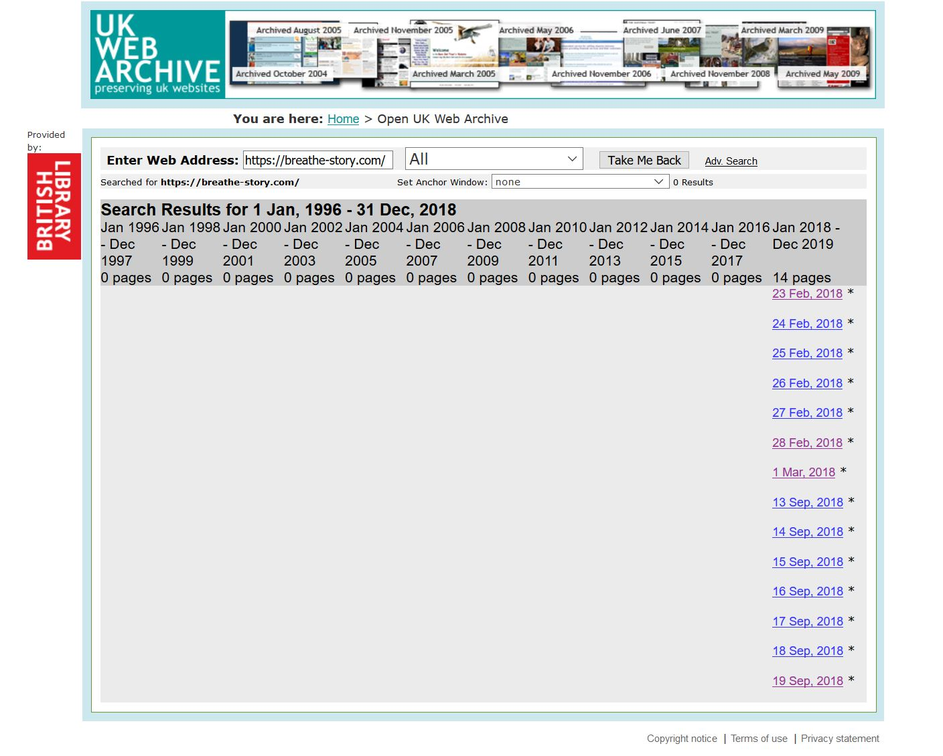
Screen capture of the UK Web Archive showing the amount of crawls for Breathe

Slide 44
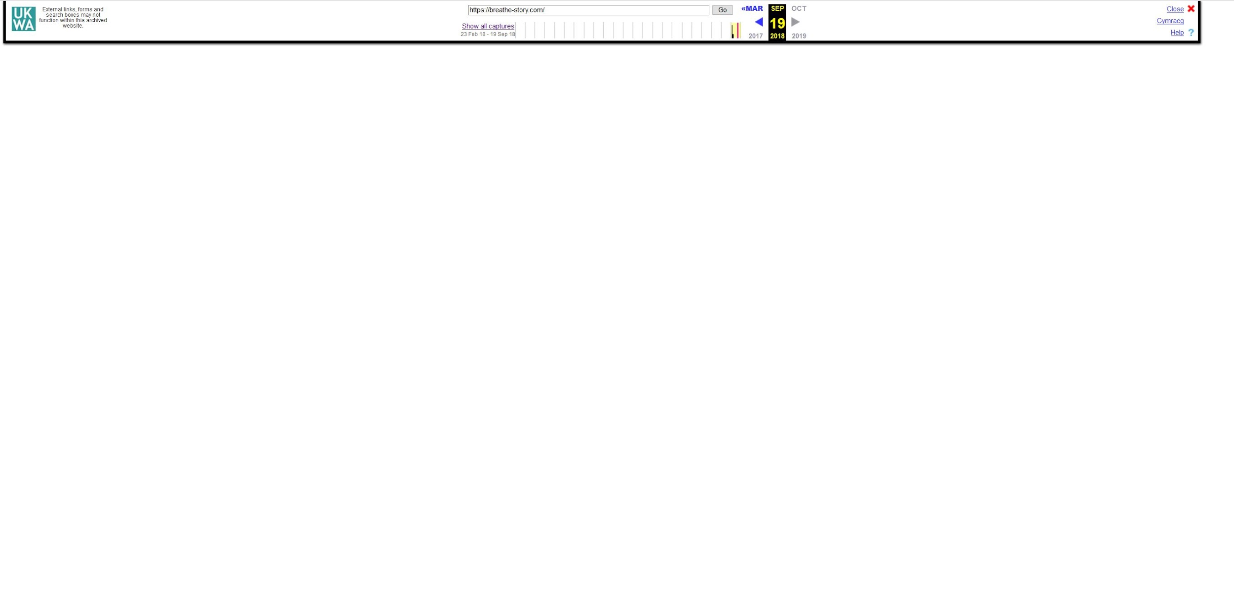
Screen capture of Breathe as displayed in the UK Web Archive
Notes:
URL does not change from page to page
Dynamically generated story that makes it challenges to capture the content

Slide 45
Webrecorder

Slide 46

Screen capture of Breathe (cover page) in Chrome DevTools on Linux desktop computer
Notes:
Breathe in Chrome dev tools on desktop
image visible in the code
showing that it can be grabbed from its source on the live web
Webrecorder doesn’t currently support mobile devices, but we wanted to see if the text could at least be captured as well as any functionality

Slide 47

Screen capture of Breathe (cover page) within Chrome (v60) within Webrecorder Player
Notes:
Breathe as displayed within recorder browser
bc of this we can get the background image. which also means that we can't get the overlay text because it is white

Slide 48

Screen capture of Breathe (page 1) in Chrome DevTools on Linux desktop computer
Notes:
Breath page 5 in Chrome on desktop

Slide 49

Screen capture of Breathe (page 1) within Chrome (v60) within Webrecorder Player

Slide 50
Next steps
Identify URLs of individual pages to crawl with Heritrix
Engage with Editions at Play to better understand how Breathe was created
Engage with Webrecorder community to see whether and how the text of the narrative can be captured

Slide 51


Thank you! @caylinssmith, #uknpld caylin.smith@bl.uk emerging-formats@bl.uk
Acknowledgements: Nicola Bingham, Ian Cooke, Maureen Pennock, and Adam Leggott

Slide 52
Panel discussion
Learning from previous experiences
Creating a body of knowledge - with case studies
Organising events to accrue knowledge, form networks
Working with creators and industry, including tech companies
Standards and standardisation:
how soon is too soon for standards?
opportunities for open source advocacy?
what is our role as preservation professionals?
System suppliers and service suppliers
Emulators and emulation for operating systems etc
Leveraging developer tools for digipres outcomes
Notes:
Learning from previous experiences - eg Web Art
Art360 app - bringing digipres info to artists
Creating a body of knowledge - with case studies
Should we try to document the case studies centrally? Via DPC?
Organising events to accrue knowledge, form networks
Yale ‘Is This Permanence’ event
Central Saint Martins event Spring 2019 - Judy
Complex Digital Objects group - Caylin and Patricia
Working with creators and industry, including tech companies
Bring them into the discussion - learn from them and give them our preservationist perspective - Patricia Tate artist example
Standards and standardisation:
how soon is too soon for standards?
Will we fail if we try to compel standardisation at this point? Is it too early?
opportunities for open source advocacy?
What can we learn from open source advocacy in other domains eg PREFORMA? Formal project?
what is our role as preservation professionals?
How do we get a balance between stifling creativity / R&D and pushing standards and norms?
System suppliers and service suppliers
DROID and Pronom? Preservica, Archivematica, etc - too soon? How to engage them?
Emulators and emulation for operating systems etc
How can these help - Patricia?
Leveraging developer tools for digipres outcomes
Environment emulation for developing apps - could they serve a preservation purpose

Slide 53
Next steps
Organise events to build knowledge and form networks
Create working groups to co-ordinate activities in the networks
Create forums for discussion by the networks - Slack workspaces / channels?
Invite industry / makers to present their work / expertise
Talk to creators about preservation - explain our work to them, in clear language
Don’t miss: 9 March 2019, CSM London - Vanishing Point: The Curation and Preservation of Virtual Reality
http://bit.ly/VanishingPoint_CSM

